Slide 1
Developing a cardiovascular disease prevention strategy for people living with HIV
Sponsors of REPRIEVE
Notes:
One of the most exciting things about REPRIEVE is that it is a partnership between the scientific community and the general community. We are trying to solve problems that face human beings, and through a good partnerships we can come up with ideas that have a meaningful result. I want to thank all those who were kind enough to participate in the REPREIEVE trial. The participants are the true heroes and heroines of the REPRIEVE study because you sacrificed and gave of yourself for others so we could learn how to answer an important question. Some of you may be aware, but in the community forum we are going to talk a lot about heart disease or what we call “cardiovascular disease,” That’s really important because many of us know friends, family, neighbors and acquaintances who have had heart attacks or strokes, and that is what heart disease and cardiovascular disease is about. When we think about the lives of human beings, we want them to be long, fruitful, quality filled and free of health problems like heart disease. That is what we were all about when the REPRIEVE Team got together as a group back in 2013 and designed this study. We partnered with community members to make sure the study really was addressing an important question for them, and we designed the study in a way that it would fit into people’s lives.

Slide 2
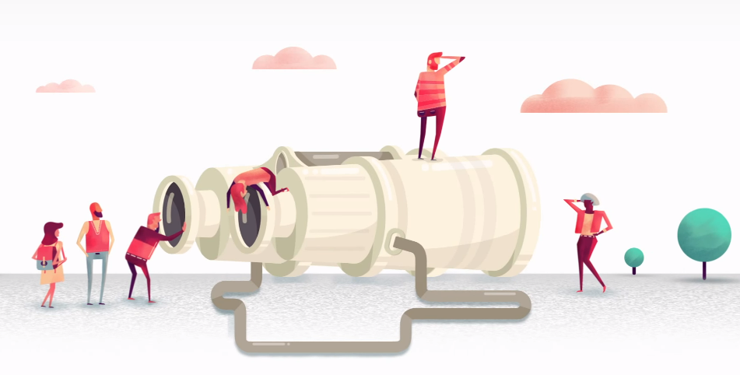
Background: Why REPRIEVE?
Notes:
Okay, so why REPRIEVE? Why was it important that we do this study?

Slide 3
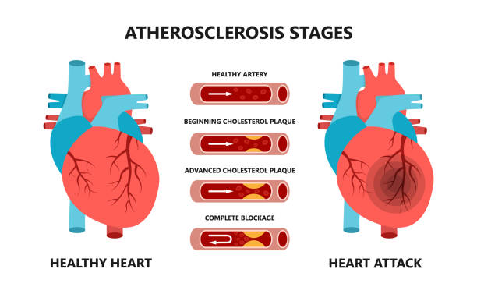
What is cardiovascular disease?
Cardiovascular disease: heart and blood vessel disease (also called heart disease), includes numerous problems, many of which are related to a process called atherosclerosis.
Atherosclerosis (known as “hardening of the arteries): a condition that develops when a substance called plaque builds up in the walls of the arteries.
This buildup narrows the arteries, making it harder for blood to flow through.
Sometimes a blood clot forms and can block the blood flow.
This can cause a heart attack or stroke
Image courtesy of istock
Notes:
What is heart disease, or what we call “cardiovascular disease”? This is a disease of the blood vessels. Some people know it as hardening of the arteries or atherosclerosis. Put simply, it is that your heart pumps blood all around your body through an intricate system, but at the same time your heart is a big muscle and needs to be supplied with blood, too. There are specific blood vessels that supply and feed or nourish the heart, like watering your lawn or taking a drink of water yourself. Those blood vessels for the heart can become blocked up like the plumbing in your house or your sink so no water gets through. In the same way if those vessels get blocked up, no blood can get through and so we can’t nourish the heart muscle cells or take away waste products from the cells. This causes those heart muscle cells to die. The same thing can happen in your brain which is called a stroke. A stroke is when the blood vessels for your brain are blocked up and so the brain is not getting the kind of blood supply it needs. These heart attacks and strokes can happen when there is a build up of deposits we call plaque in our blood vessels. If you have ever removed your sink drain cover and looked in the pipes, you might see a lot of gunk in there there. This is similar to the plaque that builds up in our blood vessels. Well, some plaque gets into our blood vessels from the foods we eat and for other reasons like other health problems or our genetic make up. As the plaque gets bigger, our blood vessel get narrower and there is a sudden event that can occur where a blood clot forms in that narrowed blood vessel and all the flow stops. That is what causes that clutching chest pain that people feel when they say they have a heart attack or why somebody suddenly can’t speak or they lose function in one of their arms when they have a stroke. So, these are the reasons why we were created the REPRIEVE Trial and the background behind this.

Slide 4
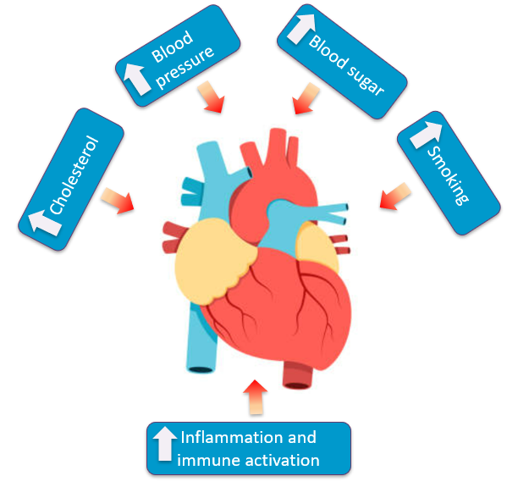
People Living with HIV Have an Increased Risk of Cardiovascular Disease (Heart Attack or Stroke)
For people living with HIV (PWH), the risk of having a heart attack or a stroke is increased.
Some of this risk is driven by well-known heart disease risk factors (like high cholesterol, diabetes, high blood pressure, and smoking).
And some of the risk is driven by HIV-related inflammation and immune activation.
Inflammation: the body’s immune system’s response to an irritant which could be a virus, a germ or a foreign object like a splinter
Notes:
For people who have HIV, their risk is actually increased, and it's increased by 50 to 100 percent when you compare people to people who don't have HIV but otherwise seem pretty similar with similar characteristics. Now, some of this happens because we have other problems that we know about like high blood pressure, high cholesterol or high lipids or fats in the blood, and high blood sugar if you have diabetes. These problems can all lead to plaques. And then smoking, we've known about for many years, is associated with a higher risk of heart disease or strokes and heart attacks. But some of this is also driven by HIV itself. HIV is a viral infection that we have yet to cure and when you have HIV there is sort of this ongoing stimulus in your body that's irritating you, kind of like somebody nagging you in your ear all the time 24/7. We call that inflammation or irritation or immune activation and that plays a special role in helping plaques to build up in people who have HIV. All of these things can contribute to heart disease even when you're doing a very good job of controlling your HIV. Even if you're controlling it perfectly, there is still this level of irritation or inflammation like that person talking in your ear 24/7.

Slide 5
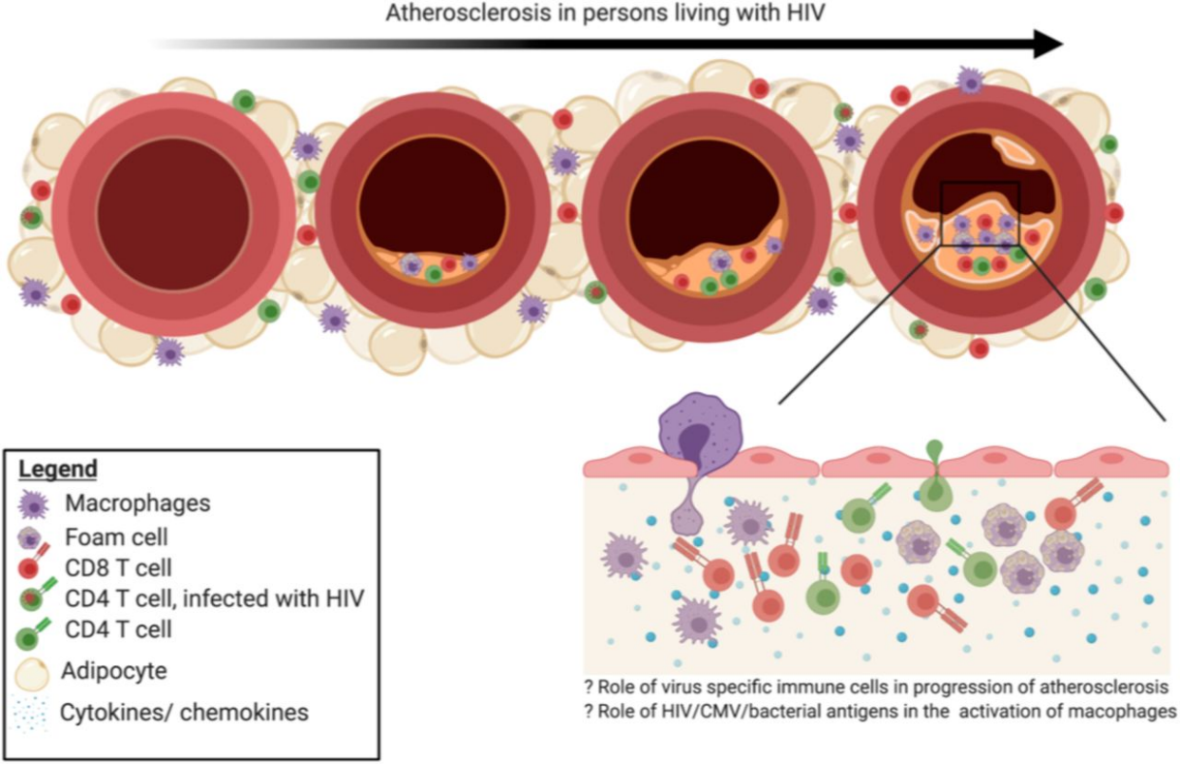
Cardiovascular Disease in the Setting of HIV
About 50% of people living with HIV have plaque in their heart’s arteries, even with no chest pain symptoms.
HIV-associated inflammation and immune activation are involved in the build-up of vulnerable plaque in the heart’s arteries.
This plaque often has features that make it more vulnerable to rupture.
Role of HIV virus specific immune cells in progression of atherosclerosis
Markers of immune activation related to inflammation, altered in the setting of HIV
Image adapted from C. Wanjalla, et al. bioRxiv, 2020
Notes:
So if we look at this nice cartoon which shows a picture of blood vessels, on the left we have a nice open blood vessel and then as you move to the right of your screen you can see that there are cells that build up and some of those cells are immune cells. These are cells where there is build up of plaque because these immune cells are causing some further irritation and it leads to the plaques growing. But it also makes these plaques a little different. Whereas some plaques might be hard like a rock with a bunch of calcium in them, these tend to be softer and more pliable they tend to bust open a little bit more. So, even people who seem like they're pretty healthy with HIV may have some buildup of this plaque and not even realize it and much of this is because of this inflammation. We like to think of this plaque as a little bit more vulnerable to break open or bust open and when it does that it often leads to a clot that can block off that blood vessel. We've been able to measure this in a number of different studies.

Slide 6
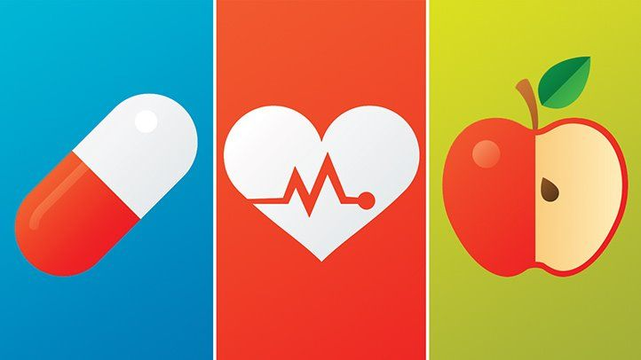
How can cardiovascular disease be prevented among PWH?
For people living with HIV, important steps to prevent cardiovascular disease include:
taking antiretroviral therapy
not smoking
keeping cholesterol, blood pressure, and blood sugar in good range
eating well/exercising
Are such strategies enough to prevent heart attacks or stroke among PWH?
Do strategies, like statins, known to prevent cardiovascular disease among people without HIV work for PWH?
Image courtesy of Depositphotos.com
Notes:
How can heart disease or cardiovascular disease be prevented in people with HIV? Well, it's very important that people that people take HIV treatment known as antiretroviral therapy, or the cocktail or one pill once a day, or some people take shots now too. We know that if you have HIV and it's not taken care of that will lead to more problems with your heart and, of course, people get sick from the HIV. So, it's very important to take your medication because that helps to decrease the inflammation from HIV itself, and if you're not smoking cigarettes that's great because that reduces your risk for heart problems even more. If we can also manage your cholesterol, and your blood pressure, and your blood sugar in a good range and of course, if you exercise and eat well, these are all healthy things. But are these strategies enough to prevent heart attacks and strokes? That's the question. We've known for years that besides an apple a day to keep the doctor away, there are pills called statins that can prevent heart disease for people without HIV. We're wondering if could these possibly work for people who have HIV since they work for other people.

Slide 7
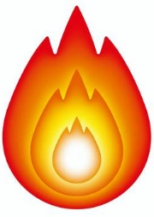
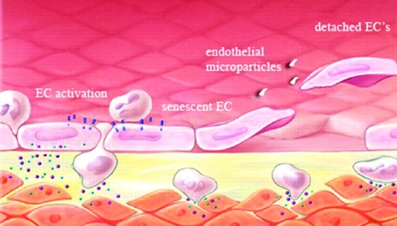
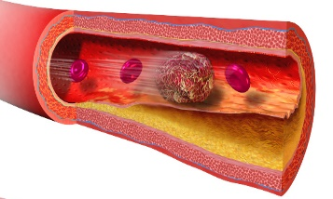
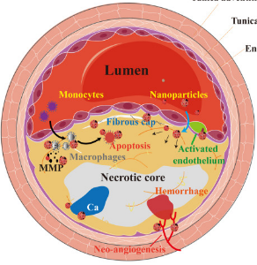
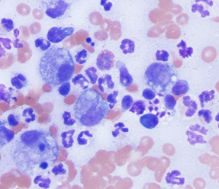
Why statins?
Statins’ primary effect is to lower low density lipoprotein (LDL) cholesterol
Elevated levels of LDL cholesterol have been associated with heart disease events
Statins have many other beneficial effects to reduce cardiovascular disease
Anti-inflammatory
Improved health of vessels
Anti-thrombotic
STATINS
Plaque Stabilization
Immunomodulation
Image adapted from C German & J Liao, Arch Toxicol 2023
Notes:
So what's a statin? Well, a statin is a particular medication that is used to lower cholesterol. It lowers a specific kind of cholesterol that we call LDL, sometimes known as your bad cholesterol. This is a kind of cholesterol that, when it builds up, it causes more of those plaques or hardening of the arteries. So statins reduce that. But statins also do other things besides that. They're anti-inflammatory, they stop blood clots from occurring (what we call antithrombotic), they affect the immune system, they cause certain cells to not be as angry, they improve the health of blood vessels, and they often stabilize those plaques so they're not so squishy and make them less likely to rupture. So statins can provide a way, through many different methods, to try and lower the chances of heart disease problems or cardiovascular events.

Slide 8
But, do statins prevent cardiovascular disease events like heart attacks and strokes?
In people living with HIV statins:
lower LDL cholesterol,
decrease HIV-associated inflammation and immune activation, and,
reduce fatty plaque in the heart’s arteries.
Before the REPRIEVE trial, it was unknown if statins decreased heart attack and stroke rates among people living with HIV with low to moderate heart disease risk (people with HIV who would not likely be prescribed a statin).
Notes:
But do they prevent events like heart attacks and strokes? That’s the key question. So, in people who have HIV, we know that statins will lower LDL cholesterol. There are a number of studies that have shown they work just like they work in people without HIV. We have also had several studies which show they decrease inflammation and that irritation that's occurring so it's kind of like getting an earbud or those sound canceling headphones so that 24/7 voice is not in your ear all the time. We also know that statins will reduce fatty plaque in your heart’s arteries. We've seen this in several studies where when somebody takes a statin we can actually reduce that buildup of fats in the blood in those blood vessels. But, before the REPRIEVE Trial, we didn't really know for sure that statins would decrease heart attacks and strokes in people with HIV, particularly if they were not necessarily the kind of people that we would normally give a statin to. Now, what do I mean by that? Well, we have certain guidelines that doctors and practitioners tend to follow which tell us that if somebody has a certain level of risk for heart attack or stroke we should probably give them a statin. But if they're below that risk level then we don't always say that they need a statin. Well in our study here we were really looking at people that were not only above that risk level but also people that were below that risk level to see if a statin would help to prevent heart disease events.

Slide 9
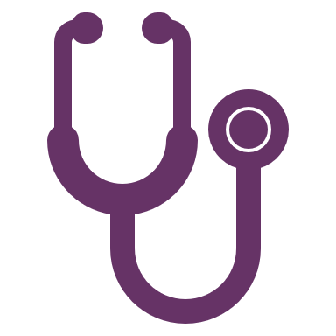
With this in mind…
Medical researchers believed that therapies to lower cardiovascular disease risk among people living with HIV needed to be tested.
Researchers came together in 2013 to develop the idea for a clinical trial to evaluate a strategy to prevent cardiovascular disease among PWH.
Notes:
So, with this in mind, we thought that this was a reasonable thing for us to test. A group of us came together in 2013 and developed this idea and, again, we partnered with the community to get their input as well and we developed what is called the REPRIEVE Trial.

Slide 10
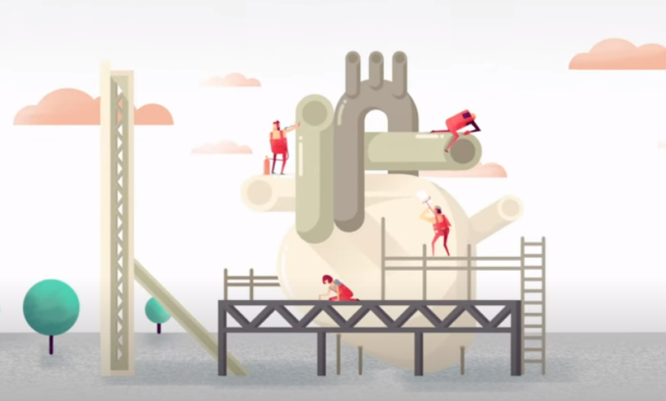
designed to address this unmet need
First multinational
randomized clinical trial
to test a strategy for cardiovascular disease prevention among persons living with HIV.
Randomized: assigning participants by chance to groups that receive different treatments. In REPRIEVE it was pitavastatin or placebo.
Notes:
What REPRIEVE really stands for is the Randomized Trial to Prevent Vascular Events in HIV. Don’t try to make all the letters somehow match in some way because you'll drive yourself crazy, but it works in there. We've got the R's and the E's and the P's and the R’s IEVS so it all works eventually anyway. So, this is a randomized trial which means like a flip of the coin we’re randomly assigning people to a group. When you walked into the study, we flipped the coin and half the people got the statin and half the people got a placebo. The statin we used in our study was called pitavastatin calcium or some may know it as LIVALO as it's prescribed. This study was really the first large, multinational study that was randomized as a clinical trial and it really is testing this strategy can we prevent heart disease or cardiovascular disease in people with HIV.

Slide 11
The Primary Goals of REPRIEVE
To determine whether treatment with pitavastatin is effective to prevent cardiovascular disease risk
To determine whether treatment with pitavastatin is safe and well tolerated
Notes:
The primary goals of this study were to determine if this medication, pitavastatin, is effective at reducing cardiovascular disease and then, just as important, to determine is it safe. I'm sure if you're like anybody else and you've been in the community you know there's a lot of talk about statins. There’s a lot out there about statins, so we wanted to know is it safe for people with HIV to be taking as well.

Slide 12
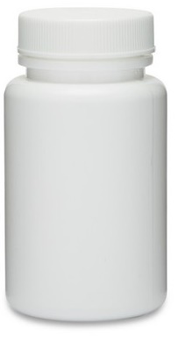
7769 Persons Between Ages 40-75
Living with HIV
Receiving stable antiretroviral therapy
At low-to-moderate ASCVD risk
ASCVD: atherosclerotic cardiovascular disease risk score
The risk score is a calculation of a person’s 10-year risk of having a cardiovascular problem, such as a heart attack or stroke
or
Placebo
Pitavastatin
4mg
Notes:
One of the first things we did was figure out who are we going to invite to this study. We want to invite people who are going to benefit the most from this, so we took people who were ages 40 to 75. They had to have a few specific characteristics. The first characteristic that we looked at was something called your risk score -- we tend use this abbreviation “ASCVD” risk score. This is a calculation, or an it's an estimate, of your risk of getting a type of heart disease called atherosclerotic cardiovascular disease. If I have somebody who is my patient and I want to know what are the chances in the next 10 years that they are going to have a heart attack or a stroke, we have this calculation to estimate this. Some people have a low risk score, like their scores may be only a two percent chance, and some people have a 20% chance. Now, of course, we'd like everybody to have a zero percent chance, but the reality is that we’re often somewhere along that range usually between one to twenty percent. It gets higher depending on if you're older, if you were born a man at birth (men tend to have more heart attacks), if you smoke you have a higher chance, or some of these other problems like high blood pressure. You have to have HIV to be in this study, of course, that's very important. And you had to be taking your HIV treatment because we really wanted to study this question in people who we thought were doing very well from the HIV standpoint and we're really trying to prevent heart disease otherwise. And we enrolled people who had a low to moderate risk score, so this is the risk score I talked about. We didn't want to enroll people who we already know would need a statin, because we didn’t really want to study that question so much. We were looking to enroll people where we wouldn't normally be given a statin or recommend for the statin we chose. As I mentioned, in the study we used pitavastatin, and it was given at a dose of four milligrams or there was a matching placebo. As a doctor on the study or a researcher, I didn't know what my study participants were taking, and they didn't know what they were taking. It was called a randomized double-blind study.

Slide 13
How REPRIEVE was carried out
Screening
and
Consent
Time
People with HIV, on ART, at low-to-moderate ASCVD risk
R
N=7769
Randomized
Placebo
Pitavastatin
Intervention
Clinical Primary
Endpoint
Major Adverse Cardiovascular Events (like heart attack, stroke) and Death
Individual components of primary endpoint and all cause mortality
Pitavastatin safety: diabetes, myalgias, muscle aches
Secondary Endpoints
Inflammatory, immunological, metabolic biomarkers
Predictors of statin effects
Notes:
This is what we call our schema. We took all these people at low-moderate risk and we enrolled 7769. Half of them got that dummy Placebo half of them got pitavastatin. The researchers didn't know and the participants didn't know what they got. What we were looking for was would somebody get a heart attack? Would they have a stroke? Would they die from heart disease? Would they somehow have some other event like they needed to have a stent or bypass surgery to open up a blocked blood vessel or something like that, or even a disease of the arteries of your legs or other places where an artery could be blocked? We looked at all of these things combined and in an individual way and we also looked at safety, particularly muscle aches or muscle problems which are known to happen with statins and diabetes which is known to be associated with the use of statins. Then we looked at a whole bunch of other things like inflammation.

Slide 14
Major Adverse Cardiovascular Event (MACE)
Cardiovascular death
Myocardial infarction (heart attack)
Hospitalization for unstable angina
Angina is chest pain cause by reduced blood flow to the heart
Stroke
Blood supply to a part of the brain is blocked or a vessel bursts causing damage to brain tissue
Transient ischemic attack
Temporary period of symptoms similar to those of a stroke, also called a TIA
Peripheral arterial ischemia
Blockage in the arteries to a body part (other than the heart or brain) that reduces blood flow and causes tissue to be starved of oxygen and nutrients
Revascularization
A medical treatment to restore blood flow when flow is limited or blocked
Notes:
What we were really looking at were cardiovascular events, we call these MACE events in the scientific technical terms, which are major adverse cardiovascular events. This is like a heart attack or a myocardial infarction or dying suddenly from a heart attack. People who are hospitalized because they had chest pain due to blood vessels being blocked off in their heart known as angina, a stroke where blood flow is blocked to your brain tissue, or what we call a TIA or transient ischemic attack (that's when you have those symptoms but they only last for a short time and they're gone within a day. You might know somebody that can't speak for a day or something like that but then they're all better). And then also I mentioned the arteries in your legs. Some people can walk a short distance, some of my patients have this, and they get a lot of pain in their legs because the arteries are not feeding the muscles and tissues in their legs and blood flow is reduced, or you needed to have a treatment known as a stent or bypass surgery to open up blood vessels and feed your heart again

Slide 15
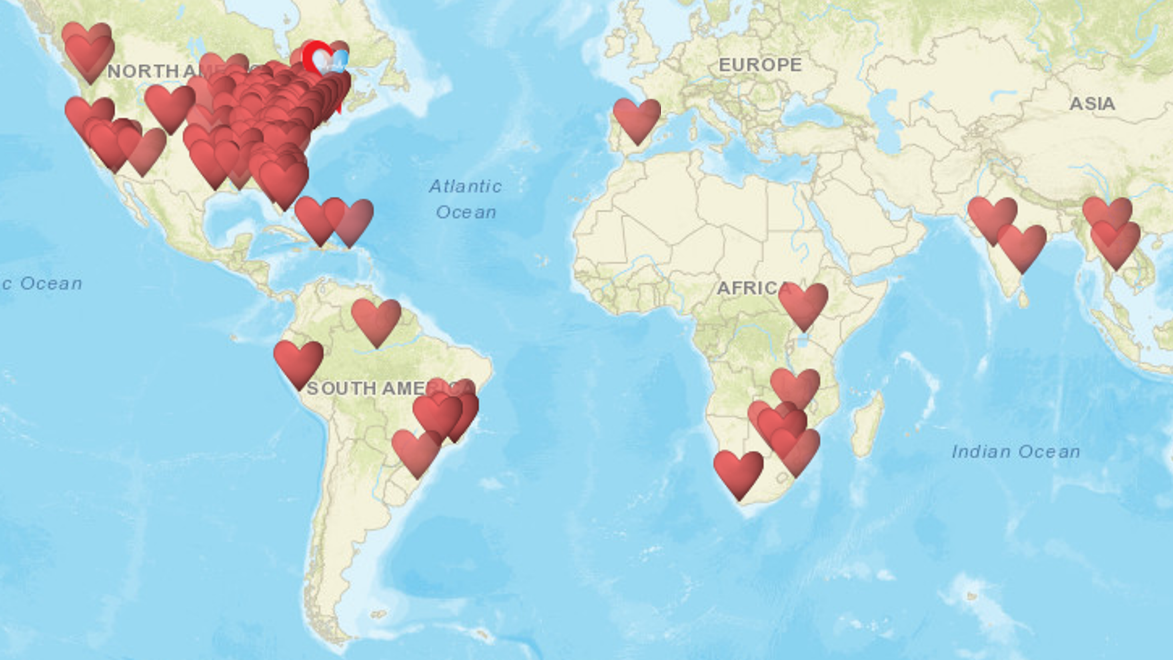
Participants were enrolled at over 100 clinical sites, in 12 countries between March, 2015 and March, 2019.
The study stopped in March 2023, after an average follow up of 5.1 years
Notes:
We did this study all over the world. It was actually at research sites on five continents and in 12 countries, these are all the hearts all over the map. We started enrolling people in March of 2015. As a principal investigator for the Cincinnati clinical research site, I had a friendly wager hoping that I could enroll the very first person on this study at my site, but a friend and colleague of mine in Alabama actually enrolled the very first participant. And we stopped enrolling people in March of 2019. And the study was stopped after an average of following people for a little more than five years by the Data Safety Monitoring Board.

Slide 16
Baseline Characteristics |  | Total (N=7769) | Pitavastatin (N=3888) | Placebo (N=3881)
Age (years) | Median (Q1 – Q3) | 50 (45-55) | 50 (45-55) | 50 (45-55)
Natal sex | Male | 5350 (69%) | 2677 (69%) | 2673 (69%)
 | Female | 2419 (31%) | 1211 (31%) | 1208 (31%)
Gender identity | Cisgender | 7367 (95%) | 3687 (95%) | 3680 (95%)
 | Transgender spectrum | 127 (2%) | 63 (2%) | 64 (2%)
 | Not reported | 275 (4%) | 138 (4%) | 137 (4%)
Race | White | 2704 (35%) | 1634 (35%) | 1340 (35%)
 | Black/African American | 3208 (41%) | 1569 (40%) | 1639 (42%)
 | Asian | 1138 (15%) | 571 (15%) | 567 (15%)
Cisgender: gender identity aligns with the sex assigned at birth
Grinspoon et al. NEJM, 2023
Notes:
What did our population look like? This is a little bit of a complicated slide but let me take you through the most important points. The average age of people who enrolled in our study was about 50 years of age and two-thirds of them were male at birth and one-third of them were female at birth. This is very important because this is one of the largest studies to enroll women with HIV anywhere across the world particularly a randomized treatment study. There were almost 2500 women worldwide in this study. We also looked at whether individuals identified as cisgender or transgender. Then we looked at the different ethnicities and races of the population and, you should note, that this study was a minority study done in white people. It was majority done in non-white individuals, reflective of the world's population. I think that's very important because it's much easier to really understand and apply the results when the study participants look like the rest of the world. So, there you see 50 was the median age, 31 percent women, and that the study was largely made up of non-white participants

Slide 17
Baseline Characteristics |  | Total (N=7769) | Pitavastatin (N=3888) | Placebo (N=3881)
ASCVD risk score (%) | Median (Q1 – Q3) | 4.5 (2.1-7.0) | 4.5 (2.1-7.0) | 4.5 (2.2-7.0)
LDL- cholesterol (mg/dL) | Median (Q1 – Q3) | 108 (87-128) | 109 (87-128) | 108 (87-127)
CD4 count (cells/mm3) | Median (Q1 – Q3) | 621 (448-827) | 620 (449-832) | 622 (445-824)
HIV Viral Load | undetectable | 5250 (88%) | 2641 (88%) | 2609 (87%)
Grinspoon et al. NEJM, 2023
Notes:
If we look at the ASCVD risk score, the average risk score was about four and a half percent. When it gets to be about seven and a half percent that's when doctors start really talking to people about if they should be taking a statin. So, you can see that our number was below this. The LDL cholesterol, that “bad cholesterol”, was an average of about 108 which is pretty mild, that's not very high. The CD4 count was very good in most patients. This is a marker of how well-controlled your HIV is, or how strong your immune system, and anything above 500 is terrific. Many of our patients were and most of the people were undetectable, 88% of them, and those few people who were detectable were very low levels, mostly below what we would call a problem.

Slide 18
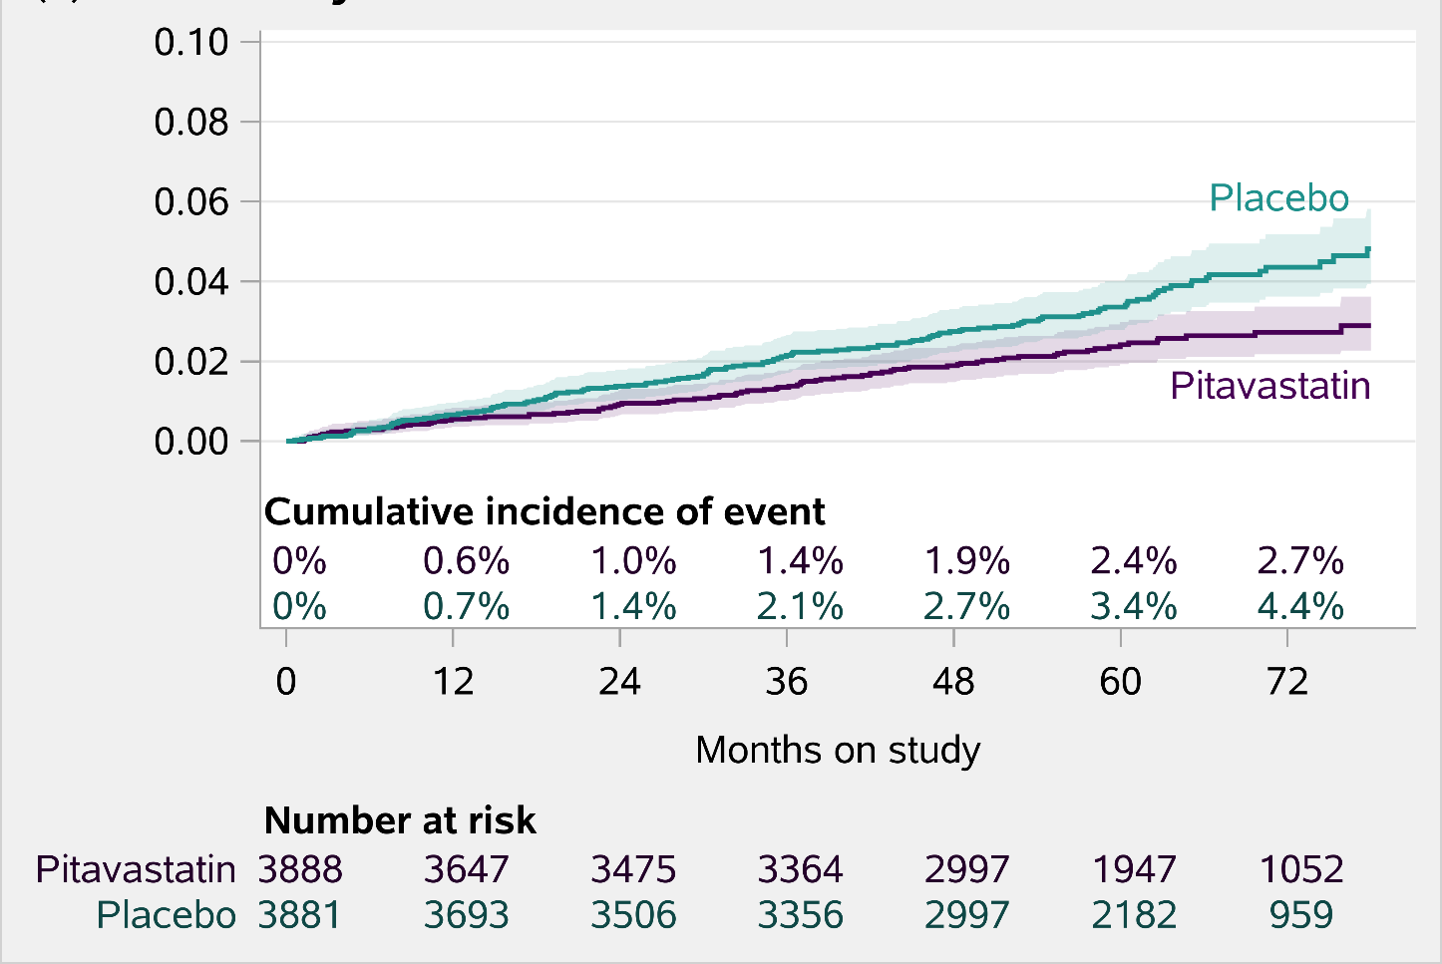
Was treatment with pitavastatin effective to prevent major adverse cardiovascular events?
Over an average of about 5 years of follow up, pitavastatin (4mg/day):
Reduced the risk of heart-related diseases such as heart attack, stroke, peripheral vascular disease, and related illnesses (‘MACE’) by 35%
First major adverse cardiovascular event
-35% vs Placebo
Grinspoon et al. NEJM, 2023
Notes:
What did we learn from this study? What's the big result? This is one of those complicated science slides, so let me take you through it because you can understand it. We follow people for an average of five years taking this statin called pitavastatin. The big message about what we found was that pitavastatin reduced the risk of heart events by 35% compared to placebo. If you look at this curve in purple are the individuals who were taking pitavastatin in this sort of more greenish-aqua color were the people taking placebo. After about 12 months, you can see the curves split and there's a difference where more people in the placebo group are developing these heart problems compared to those in the pitavastatin group. Some people might say “is a 35% difference really that important?” In the science world, that's a very big difference! You can actually see the differences the percents under the curves: about 2.7 percent of people in the pitavastatin group ultimately got a heart disease event compared to 4.4 percent of those in the placebo group.

Slide 19
Change in LDL cholesterol from entry to month 72
LDL cholesterol, mg/dL
Entry
Month 72
Entry
Month 72
Notes:
If we look at this even further, we can see that the LDL cholesterol really decreased in the pitavastatin group. Here is shown the average LDL cholesterol level and the level at month 72. It is very reassuring to see this decrease in the pitavastatin group because it means that people were taking the pills. Sometimes people go on studies and don’t always take their pills. But, we actually lowered cholesterol and it didn't lower very much in the group that was getting placebo, so there was a difference between these groups. That's a very strong measure to show that people were actually taking their treatment.

Slide 20
Was pitavastatin safe?
Nonfatal Serious Adverse Events
Incidence rate ratio: 1.01 (95% CI, 0.91-1.12)
4.16
4.13
Incidence Rate per 100 person-years
≈
Notes:
Was it safe? Well, here's the good news: overall there was a pretty equal safety in both groups. There was no difference when you look at serious events or problems, so there's not really much difference between what was reported in those people that were taking placebo or pitavastatin. Think about this for just a minute: somebody could come in complaining of achy muscles, but they may have just run a marathon and their muscles may be sore from that. We still have to document that in the study, so if they were taking placebo that would still count as muscle aches even though it was from their running a marathon.

Slide 21
Was pitavastatin safe?
Newly Diagnosed Diabetes
Incidence rate ratio: 1.35 (95% CI, 1.09-1.66)
Incidence Rate per 100 person-years
1.13
0.84
Notes:
When we look at diagnosis of diabetes there was a little bit of a difference here and this difference was significant. Not as many people in the placebo group got diabetes. More people got it in the pitavastatin group, again very small numbers of people overall, but still there was a little bit of a difference and this has been seen before in other studies of statins. But, the good news is that pitavastatin worked to prevent heart disease events in people with HIV who had diabetes. So, these people were still protected from heart disease.

Slide 22
Was pitavastatin safe?
Muscle aches and pains of Grade 3 or Greater (severe)
Incidence rate ratio: 1.74 (95% CI, 1.24-2.45)
Incidence Rate per 100 person-years
0.49
0.28
Notes:
There were more people that developed muscle aches and muscle problems with pitavastatin than those people with placebo, though this was a small number of people.

Slide 23
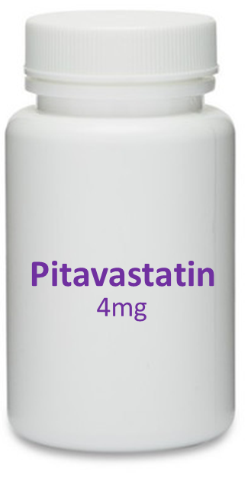
Persons with HIV
Low-to-moderate risk for cardiovascular disease
Lowered risk of major adverse cardiovascular events over an average of ~5 years of follow up
Notes:
The good news is that all of these problems did not result in people having to stop the study, so I think it's important to recognize that overall we think that the safety of this statin is very much like all the other statin trials we've seen. It seems pretty safe in people with HIV. So when we think about people with HIV who are at low to moderate risk for heart disease, the group we chose to study here, we thought that pitavastatin really made a difference. It lowered the adverse cardiovascular events on average by about 35 percent and made a difference in the lives of those people.

Slide 24
Conclusions
No prior trial has determined if cardiovascular disease events could be prevented in PWH, who would not typically be recommended to take a statin medication
Among PWH 40-75, on ART, with low to moderate ASCVD risk treatment with pitavastatin is effective and prevents cardiovascular disease events like heart attack and stroke.
Considerations should be given to expanding prevention and treatment guidelines in this regard
Notes:
Our conclusions were that there's really been no other study that was done previously that looked at these heart events in people with HIV that typically we wouldn't always recommend to take a statin medicine. So amongst people who have HIV who are between the ages of 40 and 75 who are taking HIV medicine and are at low to moderate risk of heart disease, pitavistatin is effective and prevents cardiovascular events or heart attacks and strokes. We should consider this and consider that treatment and prevention may need to change because of the results of this study knowing that we want to prevent people from having heart attacks and strokes.

Slide 25
Next steps…
Notes:
What are the next steps?

Slide 26
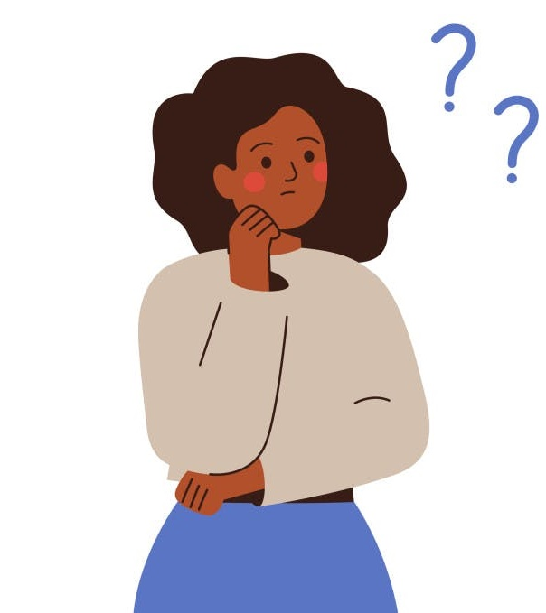
Should I be on a statin?
Now that REPRIEVE is ending, you may be wondering if taking a statin medication is right for you.
Notes:
Logically, people might now be wondering ”should I be on a statin? Is that the right medication for me?” That's a really good question.

Slide 27
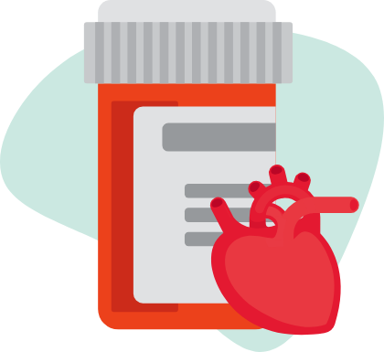
Clinical Use of Statin Medications
REPRIEVE has shown that statins may help prevent heart disease and stroke in PWH.
You and your clinician should still consider all of your risk factors, like age, smoking history, and family history, for heart attacks and strokes before initiating a statin.
Notes:
We have shown now that, in REPRIEVE, statins help to prevent heart disease. So, it's a good idea to talk to your clinician or your health care provider and say “What's my risk of heart disease? Do I have a family history risk? Am I in the right age category? Do I smoke? And so is a Statin right for me to prevent heart disease problems?” I think that it is really important to have those conversations.

Slide 28
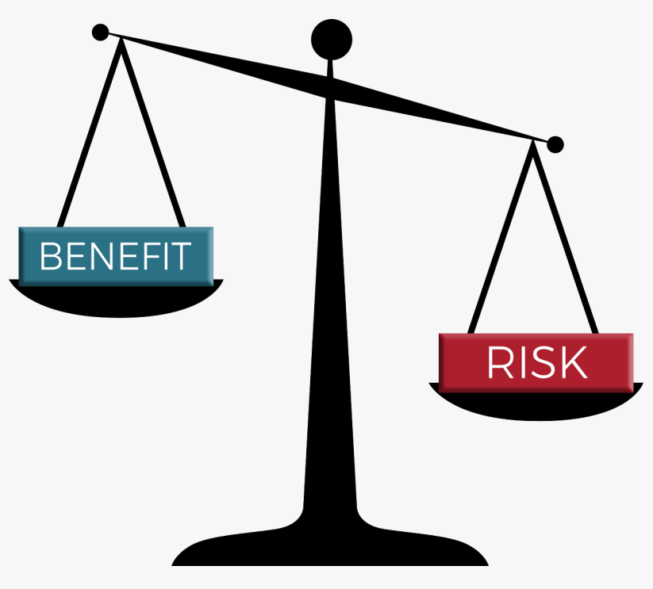
Risks and Benefits of Statins
When thinking about whether you should take a statin, first ask yourself these questions:
Do I have other risk factors for heart and blood vessel disease?
Am I concerned about taking a pill every day, perhaps for the rest of my life?
Am I concerned about statins’ side effects or interactions with other drugs?
It is important to consider your medical reasons, personal values, lifestyle choices, and any concerns when choosing a treatment
Talk to your clinician about your overall risk of heart and blood vessel disease and personal preferences before making a decision about statin therapy
Notes:
When you think about taking a statin, you have to think about the risks and the benefits. What is the chance something bad is going to happen to me if I take this statin versus what about getting a benefit? There are a lot of other questions: do I have other risks for heart disease problems? Am I worried about taking another pill every day for the rest of my life? Am I concerned about the side effects? You have to think about your own personal circumstances, your values and life choices and remember that it's not an easy question. And you can talk about it, think about it, do your research and then make a decision about whether statin is right for you or not.

Slide 29
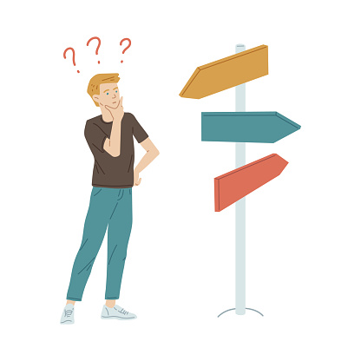
Which statin is right for me?
Pitavastatin was chosen for REPRIEVE because it has minimal interactions with antiretroviral therapy and has been shown to lower cholesterol and improve inflammation markers in people with HIV
If pitavastatin is not available, other statins that are safe to take with your antiretroviral therapy may be a reasonable choice
Notes:
Which statin is right for me? I think that's an important question. We studied pitavastatin, and that is available in the United States but it's available right now under a patent and known as Livalo that's marketed by the company Kowa. But it may not be available to everyone unless you have a specific kind of health insurance that's willing to cover it and in some countries it may not always be available because it's not available in every single country now. We looked at this medication because we knew it was very safe, it didn't interact with a lot of the HIV treatments that people were using in 2015 and it really lowered cholesterol very well. So, if it's not available to you personally or in your country or circumstances there are other statins that could will work as well so that's something to consider.

Slide 30
A Few Details About Statins
A number of statins are available for use globally, and under different brand names
In the United States, in addition to the drug used in REPRIEVE (pitavastatin (Livalo)), they include:
Pitavastatin (Livalo)
Atorvastatin (Lipitor)
Pravastatin (Pravachol)
Rosuvastatin (Crestor, Ezallor)
Notes:
So, there's a number of them that are available in different countries and I've given you a list of different ones. They come under different names as well in different countries but here's the list and many of these may also be helpful and beneficial to people if you can't get pitavastatin.

Slide 31
Things to Know About Statins
People with diabetes who take statins have much lower risk of heart attacks.
If you decide to initiate a statin, your blood sugar levels should be monitored while taking a statin.
Other serious side effects including serious muscle cell damage and liver damage were not seen in REPRIEVE.
Notes:
Things to know about statins: as I mentioned people who have diabetes are always recommended to take a statin because it does lower the risk of heart attacks and strokes. So, if you decide to take a statin you should have your blood sugar levels checked and monitored because a small percentage of people can develop diabetes while taking a statin. But, the other serious problems like muscle damage or liver damage were not seen in our study. It's very reassuring that in general statins were pretty safe in this trial

Slide 32
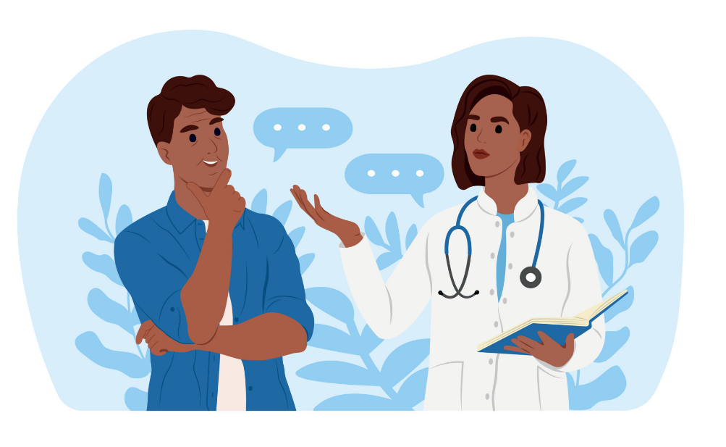
Shared Decision Making
You and your clinician should consider any possible interactions of the statin you use with any other prescription or over-the-counter drugs or supplements you take
Notes:
It's all about shared decision making, and you should have a conversation with your clinician. I had two or three of these conversations, actually this morning, with some of my patients and we agreed that we would continue to talk about it in the future. I don't necessarily just immediately write them a prescription, and we decided that they could continue to think about it. So, you have to talk about it and consider if this is the right decision for you

Slide 33
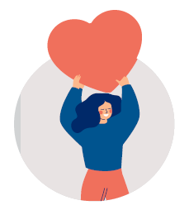
A healthy lifestyle is still essential!
Don’t forget that a healthy lifestyle is still key for preventing heart disease
Lifestyle changes are key for reducing your risk of heart disease whether you take a statin or not
Data from REPRIEVE has shown that poor heart health is associated with more blockages in the heart arteries, and that heart healthy behaviors can be enhanced in PWH
Notes:
Don't forget a healthy lifestyle style is very very important! Even just doing exercise or some kind of activity like walking, jogging, swimming, biking, running is very very important. Eating healthy foods like salads and vegetables and healthier things is important. And we've looked at people's healthy behaviors in the REPRIEVE Trial and found that we could all probably do a little better.

Slide 34
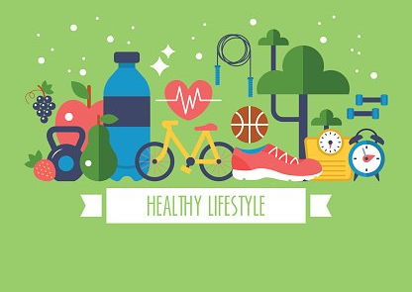
To reduce your risk for cardiovascular disease:
Quit smoking and avoid secondhand smoke
Eat a healthy diet rich in vegetables, fruits, fish and whole grains and low in saturated fat, trans fat, refined carbohydrates and salt
Be physically active more often and sit less
Maintain a healthy weight
Notes:
To reduce your own risk, don't forget that if you smoke you should quit smoking and eat that healthy diet with fruits fish and foods that are lower in saturated fats and carbohydrates. Be a little bit more active, like if you're watching TV maybe you do a little bit of exercise or something while you're watching and try to keep your weight in a healthy range. These are all important things to do

Slide 35
Full results of
Are available on the REPRIEVE website:
https://www.reprievetrial.org/learnmore/reprieve-publications/
Notes:
If you're interested in the full results of our study, these are available on our website, https://www.reprievetrial.org. Also on our website are all of our publications. We try to make these accessible and understandable for people with or without a strong science background.

Slide 36
Thank you so much for joining us today!

