Slide 1
The REPRIEVE trial: Developing a cardiovascular disease prevention strategy for people living with HIV
These slides are to be used for educational purposes only
For the complete manuscript go to https://www.nejm.org/doi/pdf/10.1056/NEJMoa2304146

Slide 2
Key REPRIEVE Results and the Utility of Statins Among PWH: What Have We Learned?

Slide 3
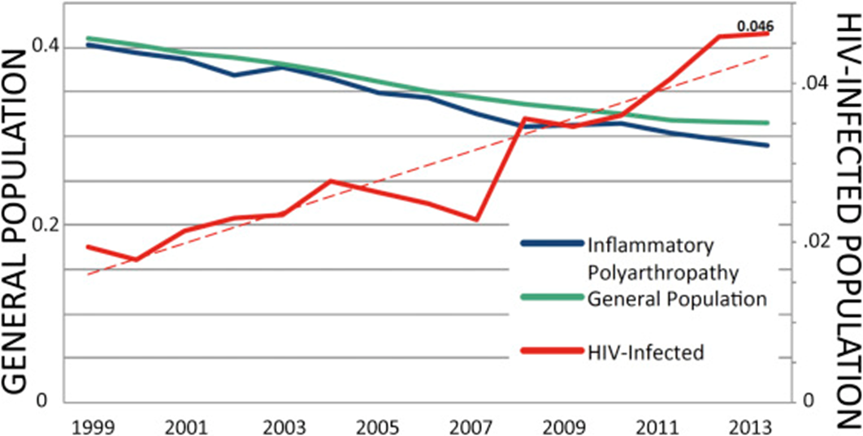
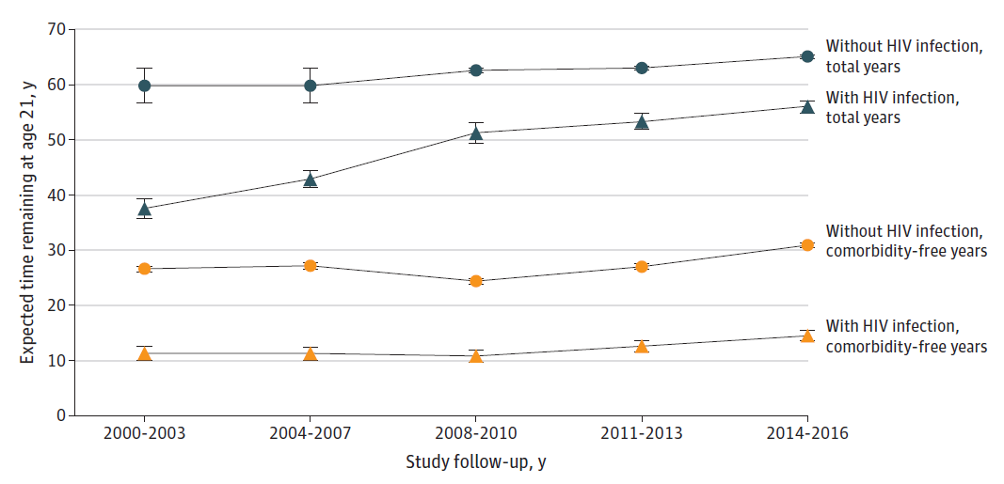
Cardiovascular Disease is Increasing in PWH, Contributing to a Persistent Comorbidity Gap
POPULATION WITH HIV
PWOH, total yrs
PWH, total yrs
PWOH, comorbidity free yrs
PWH, comorbidity free yrs
Marcus et al., JAMA Network Open 2020; Feinstein et al., Am J Card 2016
Notes:
Upper left: Cardiovascular disease (CVD) is increasing among people with HIV (PWH) even as the prevalence and rates are decreasing in the general population (people without HIV, PWOH).
Lower right: The mortality gap between PWH and PWOH is closing, but the comorbidity gap is persisting. A significant component of that includes CVD.

Slide 4
Rationale
PWH demonstrate increased cardiovascular disease (CVD) (50-100%) and excess plaque controlling for traditional risk, even at a young age
ART reduces comorbidities (SMART) but residual immune activation persists, even with good viral suppression - ART alone is not sufficient to prevent CVD
Statins lower LDL cholesterol, a main driver of CVD in PWH, but also residual immune activation and inflammation, including among PWH
Pitavastatin is a moderate intensity statin, unaffected by ART, with good LDL and anti-inflammatory properties
We hypothesized pitavastatin would prevent MACE through these effects in PWH, at low to moderate risk, for whom statins not typically prescribed under current guidelines
MACE = major adverse cardiovascular events

Slide 5
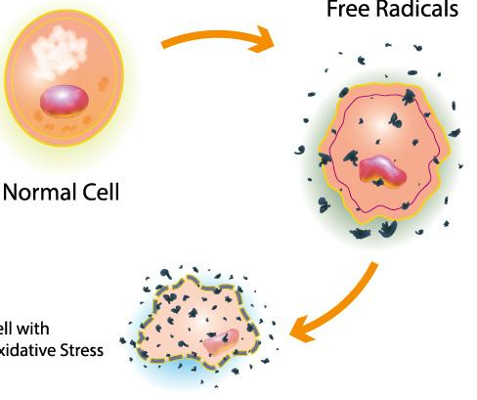
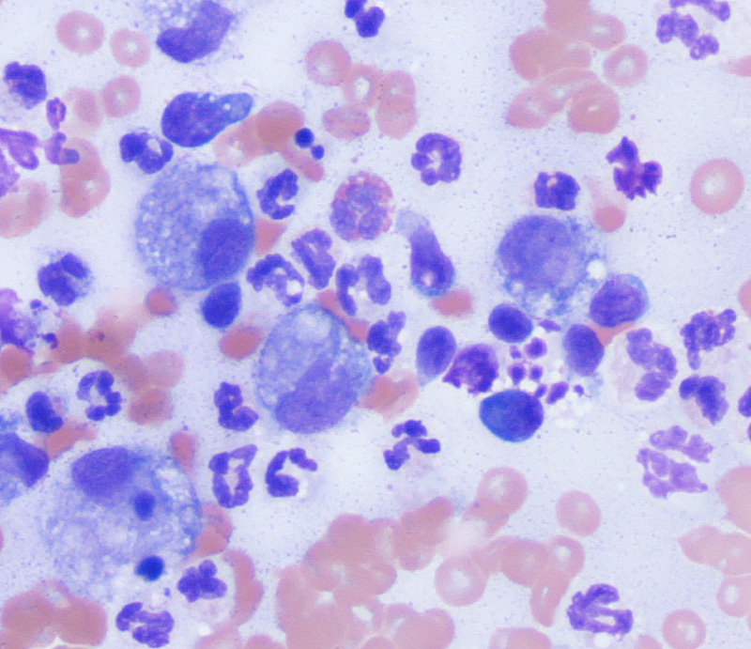
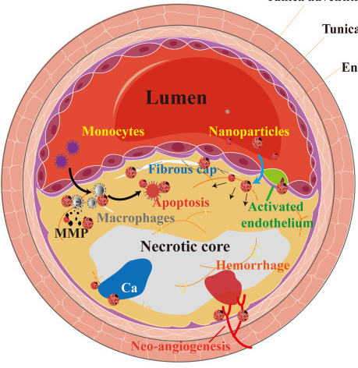
Beyond LDL: Pleiotropic Effects of Statins
Statins primary effect is to inhibit HMG-CoA reductase to lower LDL cholesterol
Statins have many other beneficial effects to reduce vascular disease
Reduced Oxidative Stress
Anti-inflammatory
Improved Endothelial Function/Vascular Tone
Anti-thrombotic
STATINS
Plaque Stabilization
Immunomodulation
Arch Toxicol 2023 97:1529
Notes:
Statins have many pleiotropic effects beyond LDL lowering. The primary effect is to lower LDL by inhibiting HMG-CoA. But, other effects include anti-inflammatory, anti-thrombotic, immunomodulation, reduced oxidative stress, improved endothelial function/vascular tone, and plaque stabilization. The REPRIEVE team continues to investigate many of these other pleiotropic effects and hopes to share results soon.

Slide 6
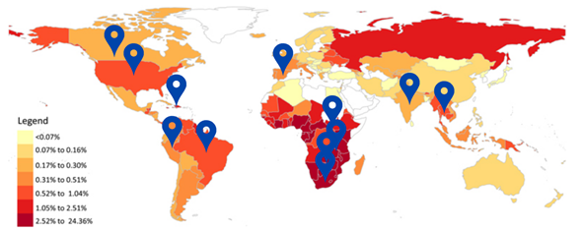
REPRIEVE Study Population
Inclusion Criteria
Exclusion Criteria
Documented HIV
Receiving stable ART
CD4+ > 100 cells/mm3
Age ≥ 40 years, ≤ 75 years
No known atherosclerotic cardiovascular disease (ASCVD)
10-yr ASCVD risk score
<7.5% LDL < 190 mg/dL
≥7.5% and ≤ 10% LDL, < 160 mg/dL
>10% and ≤15%, LDL < 130 mg/dL
Certain laboratory parameters
Current use of statins, gemfibrozil, or PCSK9 inhibitors
Known decompensated cirrhosis
Note: For LDL, to convert from mg/dL to SI (in mmol/L) multiply by 0.02586
Notes:
The inclusion and exclusion criteria are listed on the slide. As shown by the map in the upper left, REPRIEVE enrolled participants across the globe, in 12 countries and across many global burden of disease (GBD) regions.

Slide 7
REPRIEVE Trial Schema
Screening
and
Consent
Time
Asymptomatic PWH on ART, with low-moderate ASCVD risk
R
N=7769
Randomization
Placebo
Pitavastatin
Intervention
Mechanistic
SubStudy
N=805, 2 yrs
Coronary plaque,
vascular
Mechanistic
Inflammation,
immune activation
Primary Endpoint
Clinical Primary
Endpoint
CVD Death
MI
Unstable Angina
TIA & Stroke
Arterial Revasc
PAD
Individual components of primary endpoint and all cause mortality
Predictors of statin effects
Secondary Endpoints
Inflammatory, immunological, metabolic biomarkers
Statin safety and non AIDS comorbidities, DM, infections, cancer
Notes:
REPRIEVE enrolled 7,769 asymptomatic PWH on antiretroviral therapy (ART) with low-moderate atherosclerotic cardiovascular disease (ASCVD) risk scores. Participants were equally randomized to either placebo or pitavastatin calcium (“pitavastatin”) and followed through the study. The clinical primary endpoint was major adverse cardiovascular events (MACE). Embedded in the study is a mechanistic substudy looking at coronary angiography in 800 participants before and after statin initiation as well as many inflammatory markers (data to be available soon).

Slide 8
Global Enrollment

Slide 9
Baseline Characteristics |  | Total (N=7769) | Pitavastatin (N=3888) | Placebo (N=3881)
Age (years) | Median (Q1 – Q3) | 50 (45-55) | 50 (45-55) | 50 (45-55)
Natal sex | Male | 5350 (69%) | 2677 (69%) | 2673 (69%)
 | Female | 2419 (31%) | 1211 (31%) | 1208 (31%)
Gender identity | Cisgender | 7367 (95%) | 3687 (95%) | 3680 (95%)
 | Transgender spectrum | 127 (2%) | 63 (2%) | 64 (2%)
 | Not reported | 275 (4%) | 138 (4%) | 137 (4%)
Race | White | 2704 (35%) | 1634 (35%) | 1340 (35%)
 | Black/African American | 3208 (41%) | 1569 (40%) | 1639 (42%)
 | Asian | 1138 (15%) | 571 (15%) | 567 (15%)
CD4 count (cells/mm3) | Median (Q1 – Q3) | 621 (448-827) | 620 (449-832) | 622 (445-824)
Nadir CD4 count (cells/mm3) | < 50 50-199 ≥ 200 | 1409 (18%) 2392 (31%) 3706 (48%) | 688 (18%) 1202 (31%) 1859 (49%) | 721 (19%) 1190 (31%) 1847 (47%)
HIV RNA (Copies/mL) | < LLQ LLQ - < 400 400+ Missing | 5250 (88%) 617 (10%) 130 (2%) 1772 | 2641 (88%) 305 (10%) 63 (2%) 879 | 2609 (87%) 312 (10%) 67 (2%) 893
ASCVD risk score, (%) | Median (Q1 – Q3) | 4.5 (2.1-7.0) | 4.5 (2.1-7.0) | 4.5 (2.2-7.0)
LDL-C (mg/dL) | Median (Q1 – Q3) | 108 (87-128) | 109 (87-128) | 108 (87-127)
Notes:
Baseline characteristics in the pitavastatin and placebo arm are very similar, therefore focus can be directed to the total column. In the trial population, 31% of participants had female natal sex and only 35% of participants were white making the trial population highly diverse. Of note, the majority of participants had suppressed viral load.
The median ASCVD risk for the trial participants was 4.5% which is very low predicted risk and LDL-C was only minimally increased at 108 mg/dL. This is not a typical population that would be recommended for statin therapy.

Slide 10
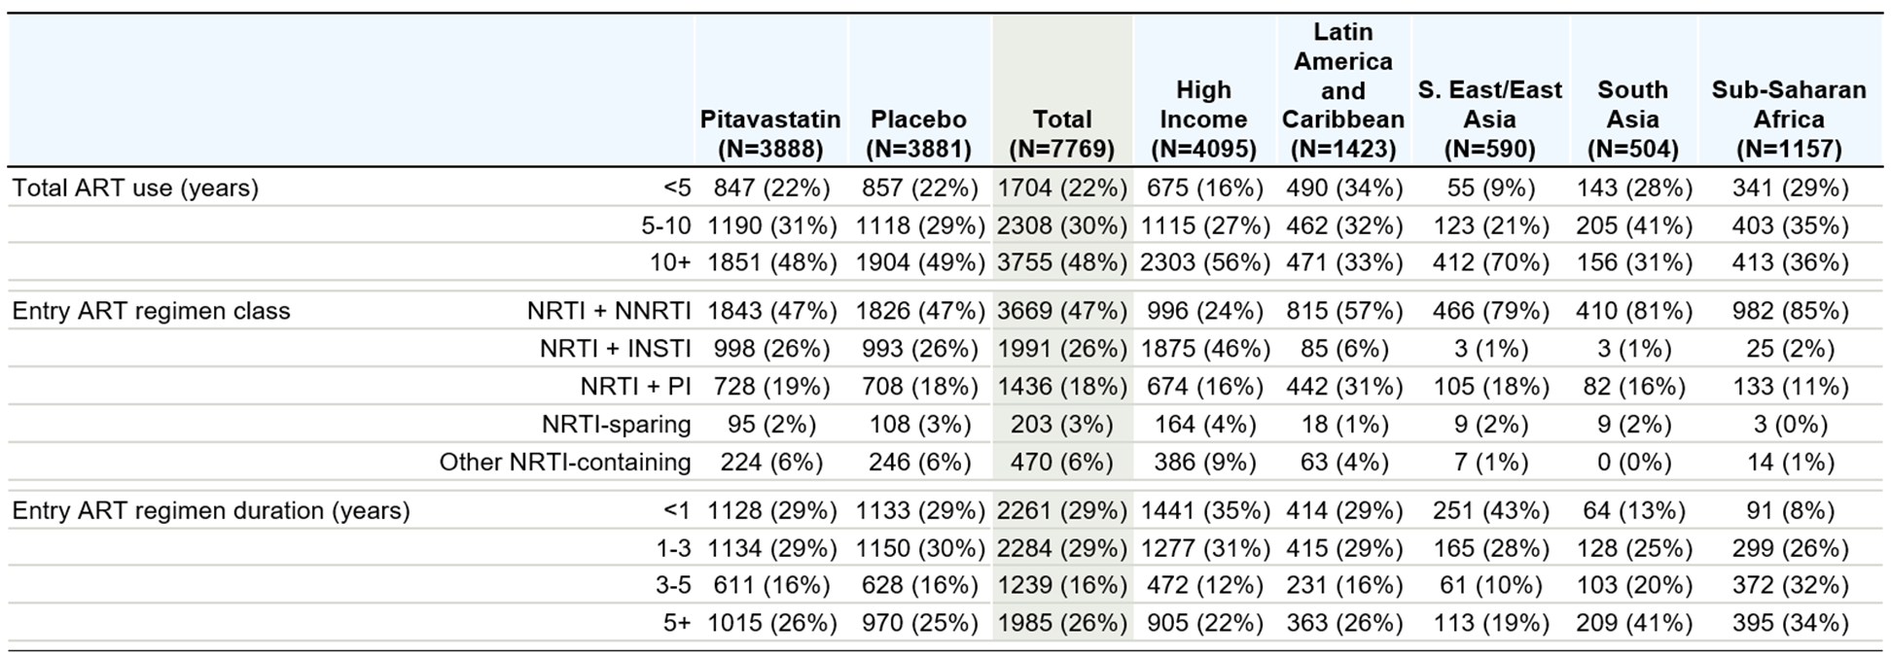
Baseline ART Regimen and Duration
Notes:
ART regimens differed across the income regions and GBDs represented in REPRIEVE. Overall, participants were well-treated and had long-term use of ARTs prior to REPRIEVE.

Slide 11
Recent Events and Trial Closure
REPRIEVE is an events driven trial with 85% power to detect a HR of 0.70 with 288 planned events
The DSMB convened at 75% of information for a pre-specified data review and closed the trial for efficacy, concluding there were no unanticipated safety concerns and that the benefits outweighed the risk of statin therapy in this group
DSMB = data and safety monitoring board

Slide 12
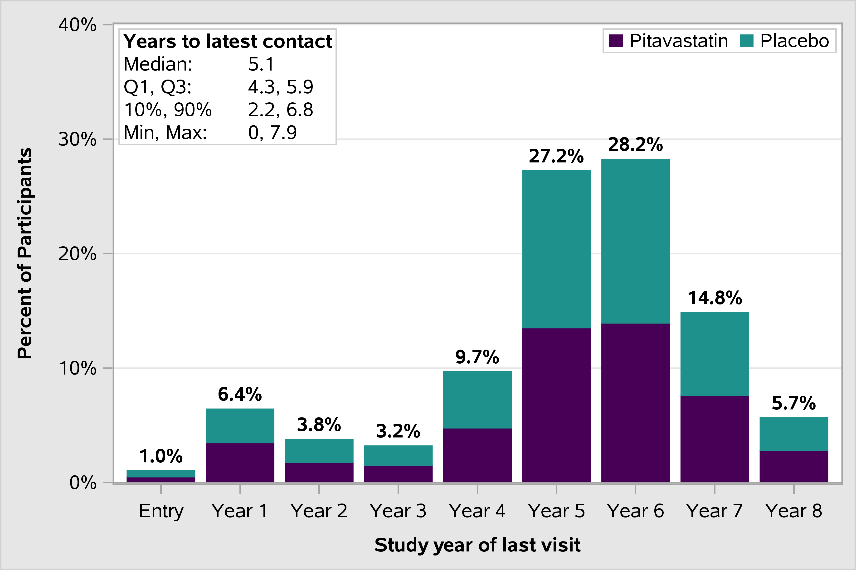
Duration of Follow-Up at Time of DSMB
Notes:
At the time of the Data Safety Monitoring Board (DSMB), the overall median follow-up time was 5.1 years.

Slide 13
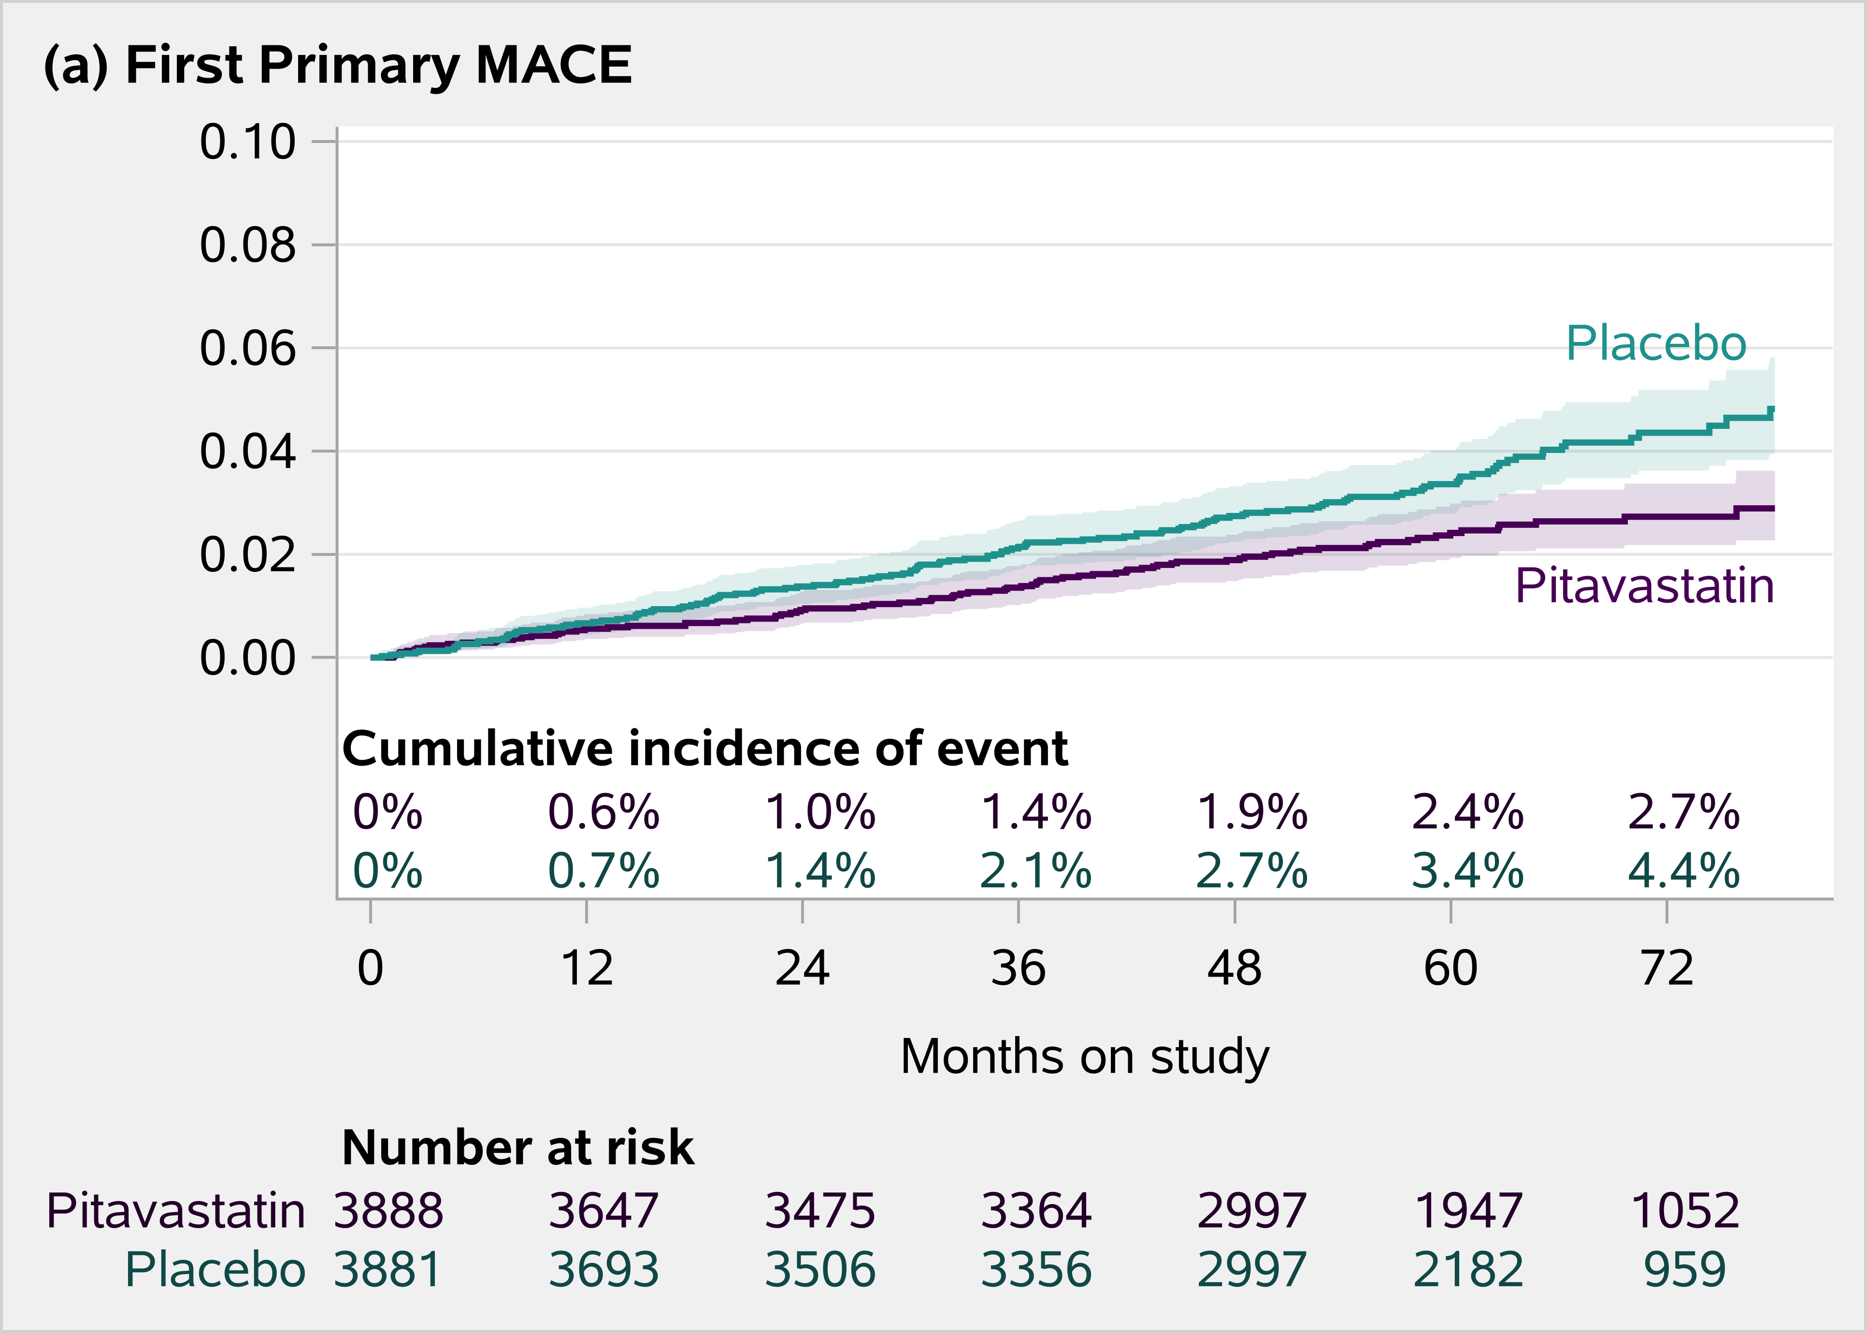
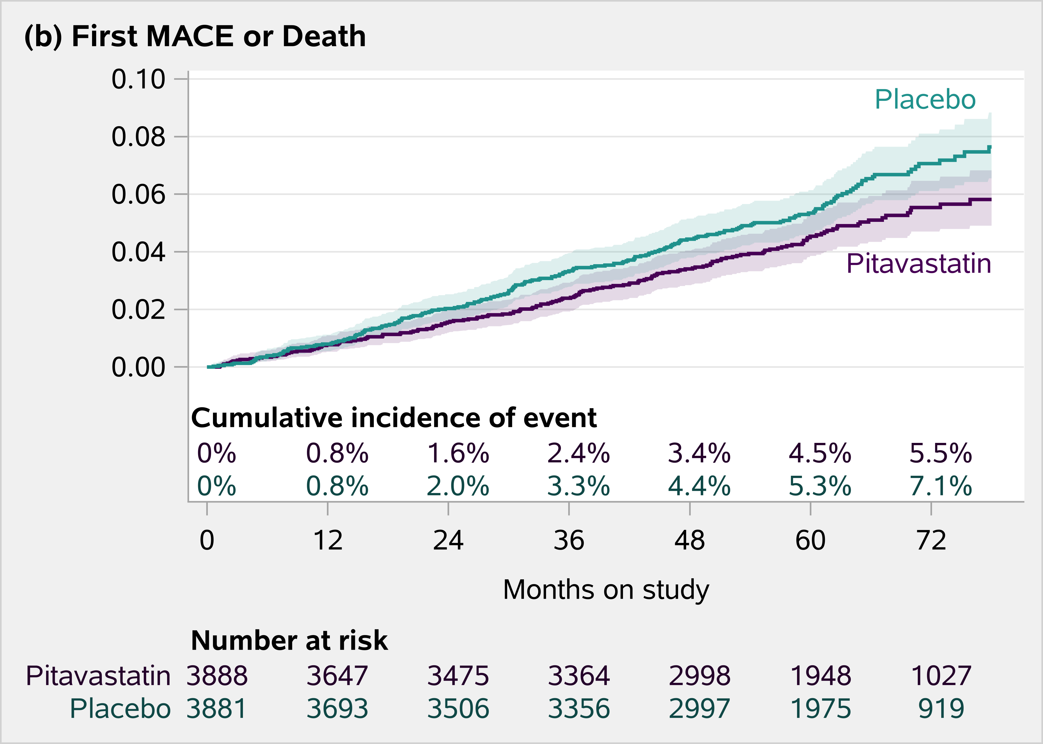
Primary and Key Secondary Endpoints
-35% vs Placebo
-21% vs Placebo
Grinspoon et al. NEJM 2023
Notes:
Pitavastatin vs. placebo led to a 35% reduction in major cardiovascular disease events (MACE), more than the hypothesized 30% reduction in MACE. Pitavastatin vs. placebo also led to a 21% reduction in MACE or death.

Slide 14
Additional Findings
Greater than 80% in both groups remained in follow up
Adherence was very good to excellent in the great majority of participants
Adverse event-related discontinuation was low in each group (2% vs 1% pitavastatin vs placebo)
Clinical initiation of a non-study statin occurred in 5.7% pitavastatin and 9.6% of placebo-treated participants, below threshold of concern
All events adjudicated vis a vis relationship to COVID; only one MACE event was definitely related to COVID.

Slide 15
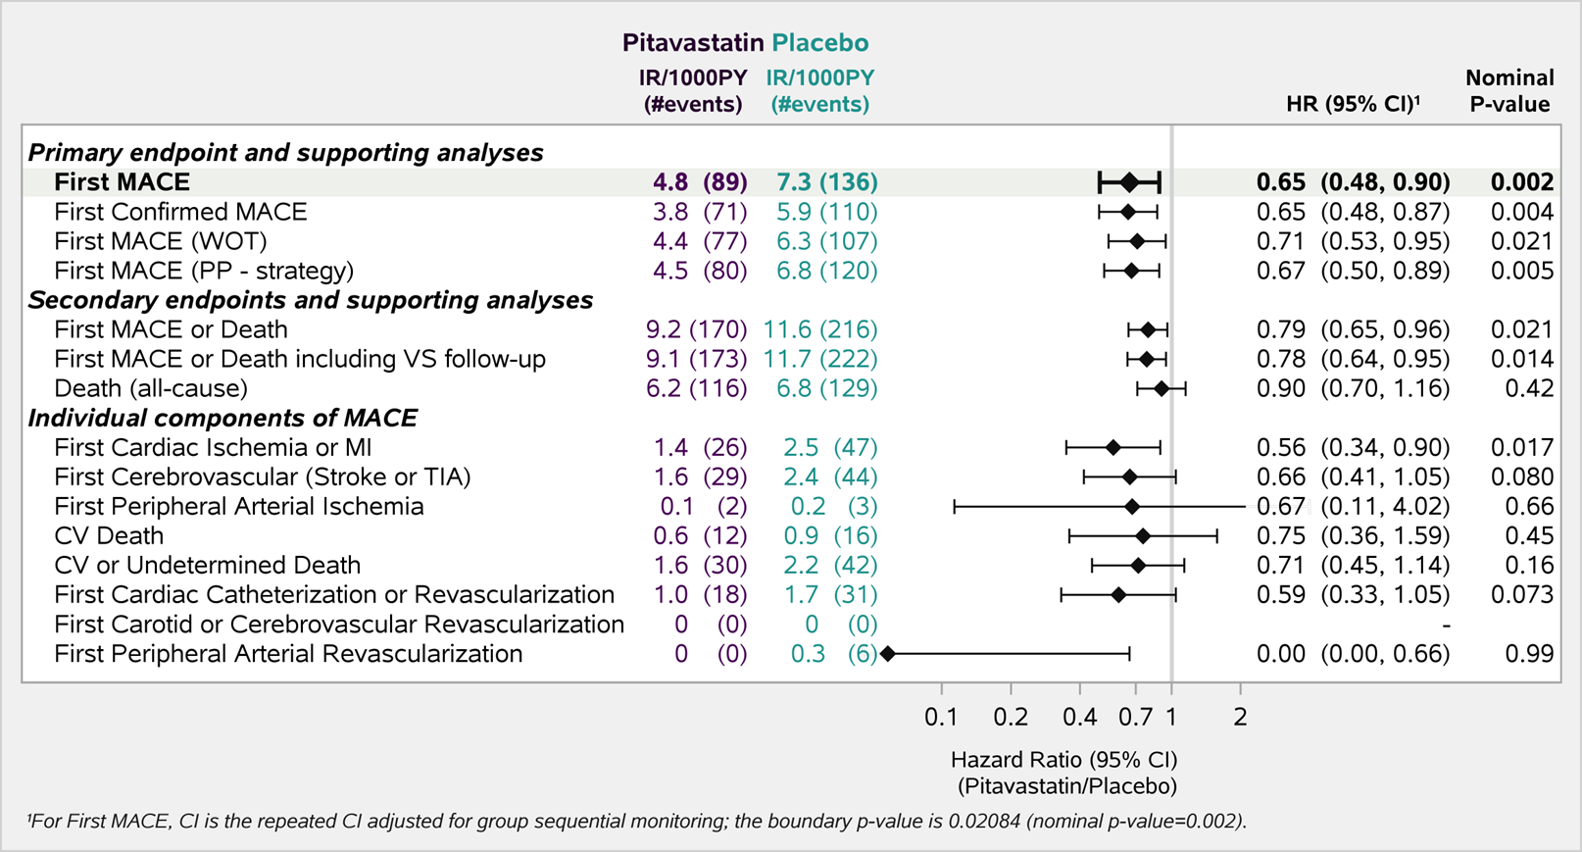
Primary Endpoints and MACE Components
Grinspoon et al. NEJM 2023
Notes:
REPRIEVE results were confirmed via a per-protocol and a while-on-treatment analysis. These results were also positive in secondary analyses which include first MACE or death.
The effects of pitavastatin also appeared consistent across individual components of MACE. Roughly half of events were strokes/TIA and myocardial infarction (MI) and the efficacy was similar for both types of events.

Slide 16
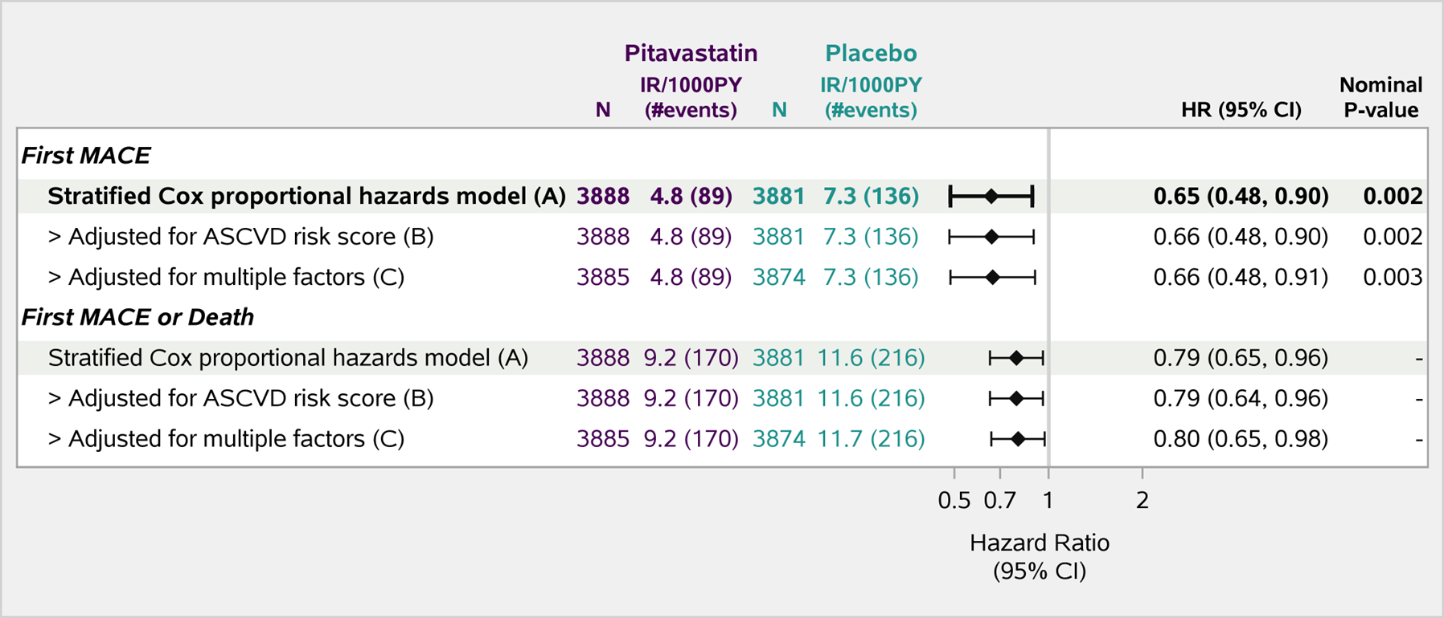
Robust Effect Controlling for ASCVD Score and Other Factors
Adjusted for: age, race, smoking, hypertension, LDL-C,
nadir CD4, total ART duration and GBD region as covariates.
Grinspoon et al. NEJM 2023
Notes:
After controlling for ASCVD risk score and other factors, the results remain consistent.

Slide 17
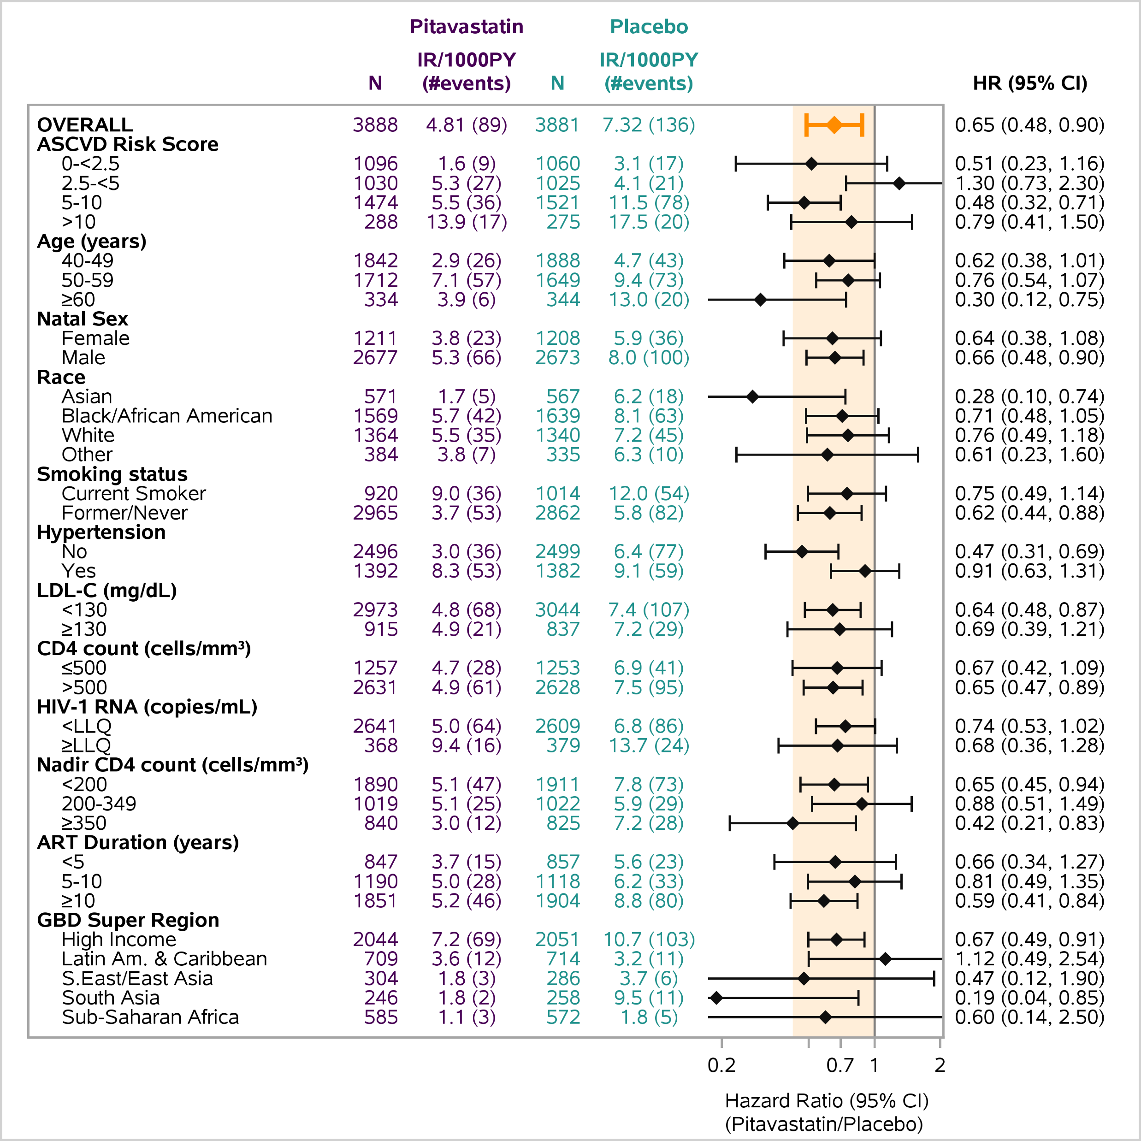
Effects on Key Subgroups
Very consistent affect across major subgroups
No treatment modification based on LDL, age, sex
Generally consistent effects across race and GBD regions
No treatment modification based on CD4, nadir CD4, HIV RNA, ART Duration
GBD = global burden of disease
Grinspoon et al. NEJM 2023
Notes:
One notable finding is that the effect size of pitavastatin vs. placebo was particularly large in South Asia.

Slide 18
REPRIEVE Population
Baseline Characteristics by Sex
 |  | Total | Men (N=5350) | Women (N= 2419)
Age (years) | Median (Q1-Q3) | 50 (45, 55) | 50 (46, 55) | 49 (44, 55)
Race | Black/African-American, N (%) | 41% | 34% | 58%
 | White, N (%) | 35% | 44% | 15%
 | Asian, N (%) | 15% | 13% | 19%
Current Cigarette Smoking | (%) | 25% | 28% | 18%
Hypertension | (%) | 36% | 34% | 39%
LDL-C (mg/dL) | Median (Q1-Q3) | 108 (87, 128) | 107 (86, 126) | 111 (90. 131)
10-y ASCVD Risk Score (%) | Median (Q1-Q3) | 4.5 (2.1, 7.0) | 5.4 (3.3, 7.8) | 1.9 (0.8, 4.3)
BMI (kg/m2) | Median (Q1-Q3) | 25.8 (22.8, 29.4) | 25.3 (22.6, 28.3) | 27.2 (23.4, 32.1)
Viral Load < LLQ | (%) | 88% | 87% | 88%
CD4 count (cells/mm3) | Median (Q1-Q3) | 621 (448, 827) | 598 (426, 795) | 679 (496, 898)
Notes:
A comparison of the men vs. women enrolled in REPRIEVE globally revealed that age, hypertension prevalence, LDL-C level, and the percent of participants with suppressed viremia was comparable between groups. Among women, a smaller proportion of participants reported white race. Women vs. men demonstrated a lower prevalence of cigarette smoking and a significantly lower 10-year ASCVD risk score but a higher BMI and higher median CD4 count.

Slide 19
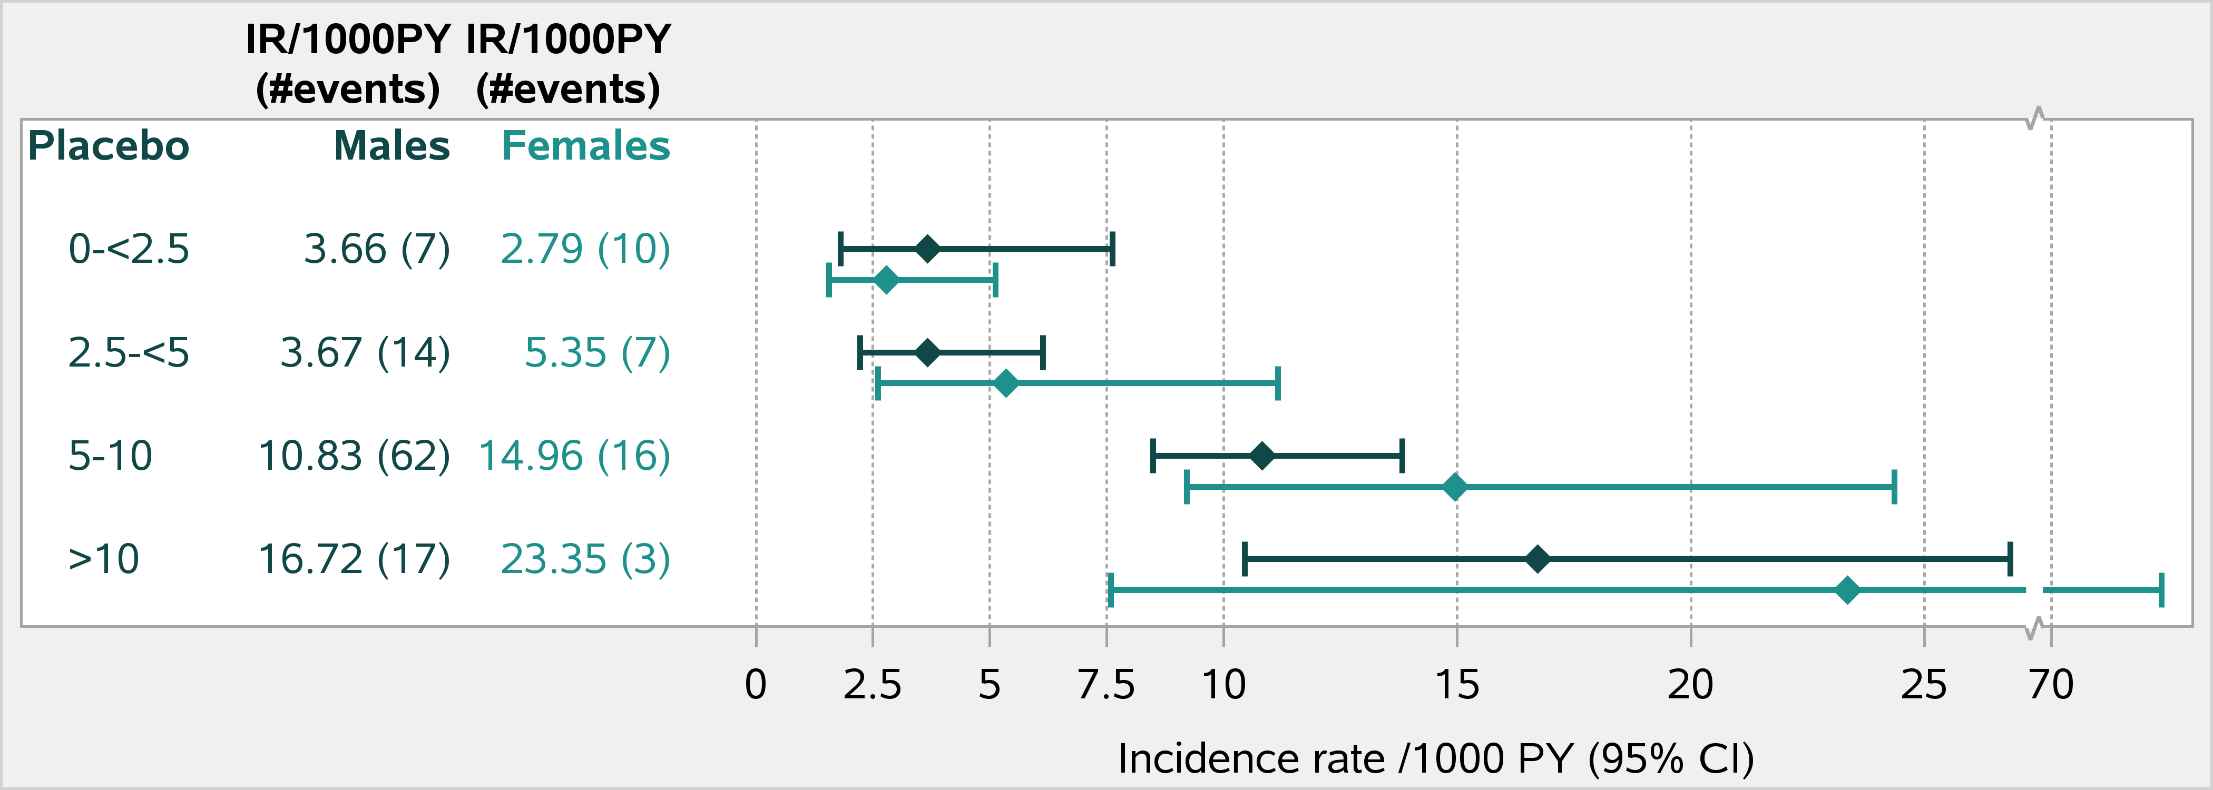
MACE Rates in 10-year ASCVD Risk Score Subgroups by Sex
Men
Women
z
men
women
Notes:
Both among men and women in the placebo arm, estimated MACE rates per 1000 person years (PY) increased along increasing 10-year ASCVD risk groups, as expected. Although confidence intervals were wide and overlapping, among those in the placebo arm with a 10-year ASCVD risk score =>2.5%, estimated MACE rates per 1000 PY tended to be higher among women vs. men.

Slide 20
Effect Size of Statin Rx to Reduce MACE = Consistent among Women vs. Men
Notes:
In the overall REPRIEVE cohort, statin therapy vs. placebo resulted in a 35% reduction in MACE over the study follow-up. The effect size of statin therapy in reducing MACE was generally consistent among women vs. men.

Slide 21
Effects on LDL and NON-HDL Cholesterol
30% reduction in LDL in pitavastatin group, no change in placebo
Durable effect over time
Pitavastatin
Placebo
Grinspoon et al. NEJM 2023
Notes:
Pitavastatin resulted in a 30% reduction in LDL cholesterol vs. no change in the placebo group with similar effects on non-HDL cholesterol.

Slide 22
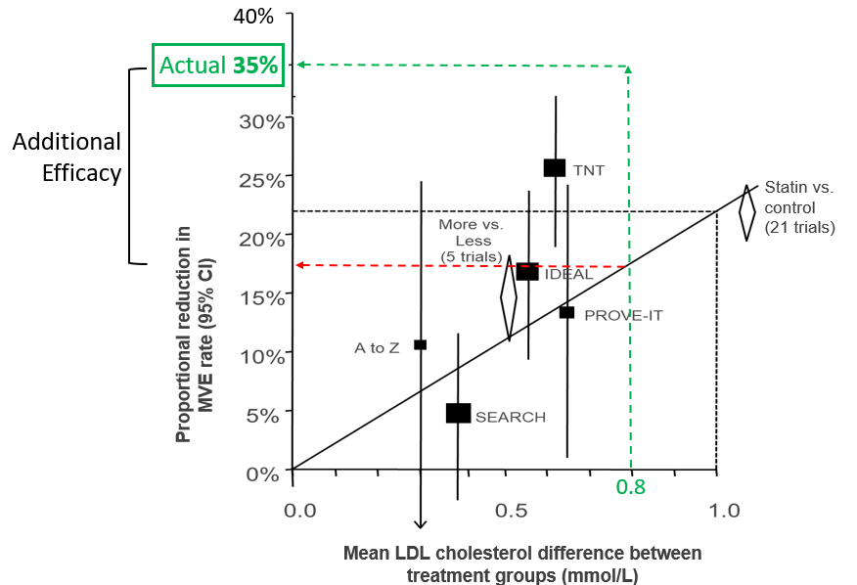
Effect Larger than Anticipated Based on
Lowering of LDL
■
REPRIEVE
LDL lowering matters but
statin effect is beyond what
is expected for LDL lowering
alone
Predicted 17%
Note: 35% is point estimate, CI % is 17 – 52%
Lancet 2010; 376: 1670-81
Notes:
The effect size observed in REPRIEVE was larger than anticipated based on the lowering of LDL cholesterol. The figure on the slide is a nomogram by the CTTC collaborative published in Lancet showing a number of large statin trials; the figure plots mean LDL-C difference between treatment groups against the reduction in rates of MACE. REPRIEVE resulted in a difference of 0.8mmol/L which would have corresponded to a predicted 17% reduction in MACE. The actual reduction in MACE rates in REPRIEVE was 35%, larger than anticipated by LDL-lowering alone. The REPRIEVE Team continues to investigate why this result occurred.

Slide 23
Safety
DSMB concluded no unanticipated safety concerns
Serious adverse events similar in each group: IRR 1.02 (0.92-1.14)
Muscle-related symptoms were higher in the pitavastatin group but were mostly mild and only 1% withdrew for muscle-related symptomatology
Diabetes rates increased in the pitavastatin group, but this increase was consistent with that seen in prior statin studies, was not significantly above rates demonstrated for the general population, and very few withdrew due to diabetes
No effect on Grade 3 ALT or rhabdomyolysis was seen
IRR: incidence rate ratio

Slide 24
Diabetes Rates in REPRIEVE vs. General Population Aged 45-64 per US Centers for Disease Control
12 MACE events in participants with diabetes:
-4 in pitavastatin group
-8 in placebo group
Placebo
IRR 1.34 (1.08-1.65)
Pitavastatin
IRR: incidence rate ratio
Centers for Disease Control and Prevention. Incidence of Newly Diagnosed Diabetes.
https://www.cdc.gov/diabetes/data/statistics-report/newly-diagnosed-diabetes.html#print
Notes:
Plotting the incidence rates of diabetes in the placebo and pitavastatin groups of REPRIEVE and compare this with the incidence rate of diabetes among people in the general population ages 45-64, the rates of both REPRIEVE groups overlap with rates in the general population. Additionally, the rates of MI were lower in the pitavastatin group among participants with diabetes.

Slide 25
Effects on Glucose
Pitavastatin
Placebo
Grinspoon et al. NEJM 2023
Notes:
There were no effects on glucose levels.

Slide 26
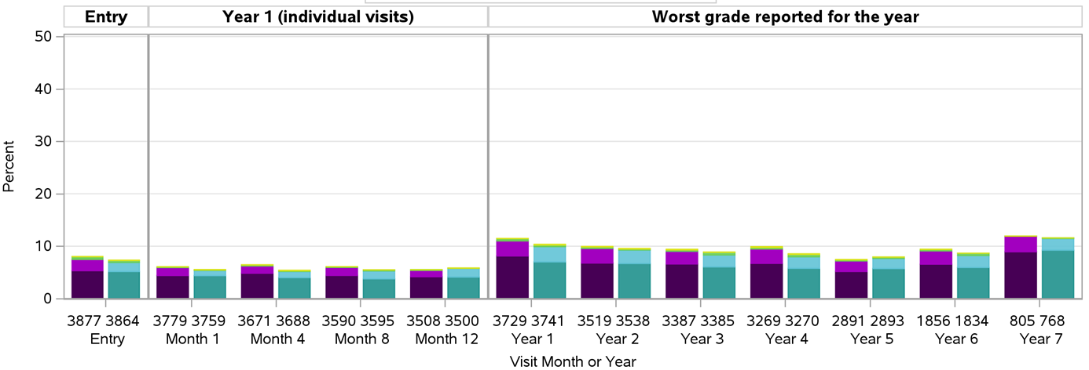
Effects on Muscle Aches and Myalgias
Muscle aches
Muscle weakness
Grinspoon et al. NEJM 2023
Notes:
Each set of bars in the figure above represents muscle aches and myalgias in the pitavastatin vs. the placebo group. Most reported events were mild; events in bright green and yellow represent events of grades 3 and 4.

Slide 27
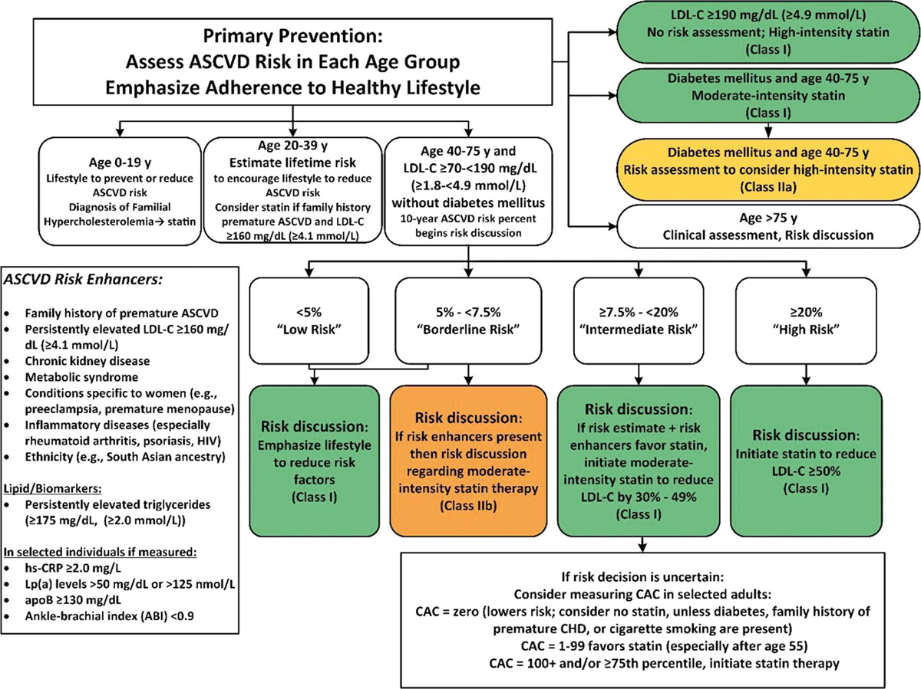
How Might the Findings of REPRIEVE Impact the Recommendations for Statin Therapy (2019 ACC/AHA Guidelines)?
HIV was recently considered a risk enhancer, but its use in primary prevention had not been studied
Previously unknown if PWH with low to moderate risk should be put on a statin and whether statin therapy would be successful in this context?
√ REPRIEVE has taught us that yes this is the case, statin therapy will prevent MACE in low to moderate risk PWH

Slide 28
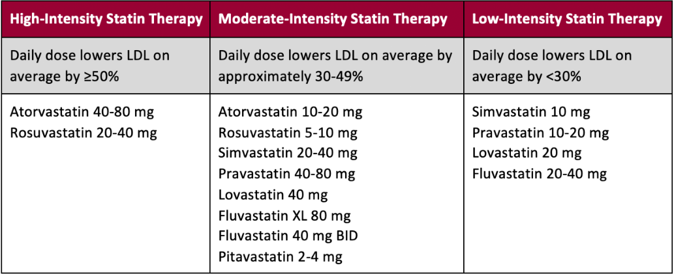
Spectrum of Statin Intensity
Notes:
There are different types of statins; pitavastatin is a moderate-intensity statin.

Slide 29
Statin Interactions with ART in PWH
Slide Courtesy of Dr. Janet Lo
Notes:
There can be interactions between statins and ARTs in PWH. Statins recommended for PWH are pravastatin, atorvastatin, rosuvastatin, and pitavastatin. A link to a helpful resource to check these interactions is provided on the slide from the University of Liverpool.

Slide 30
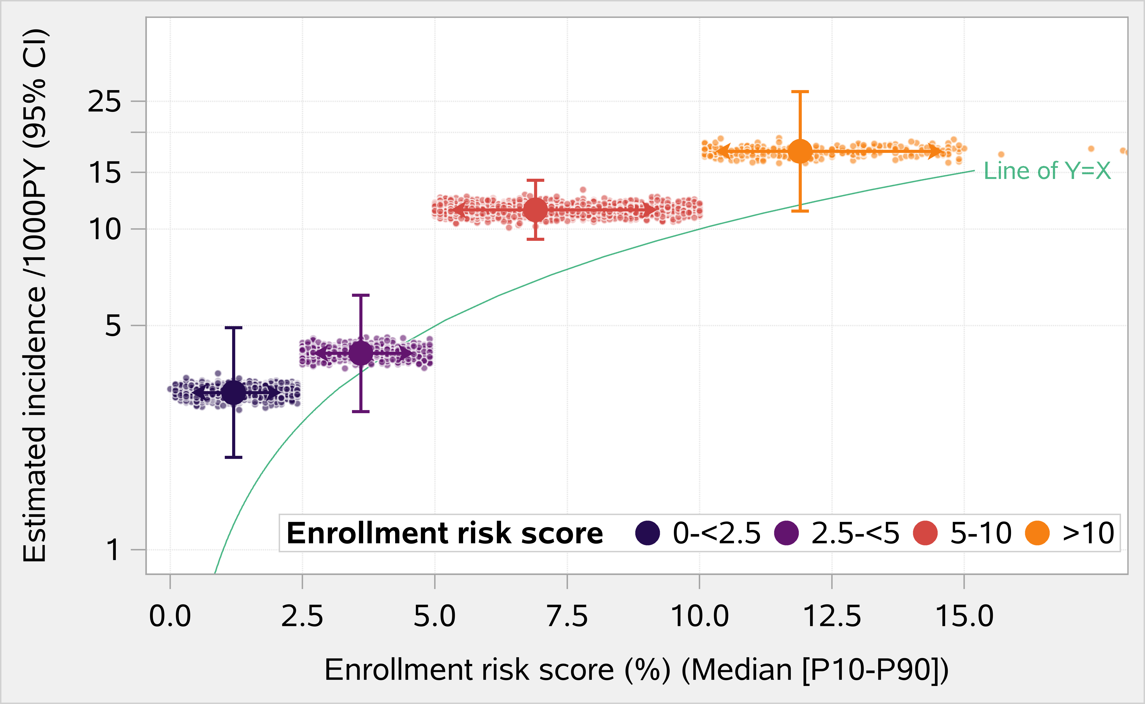
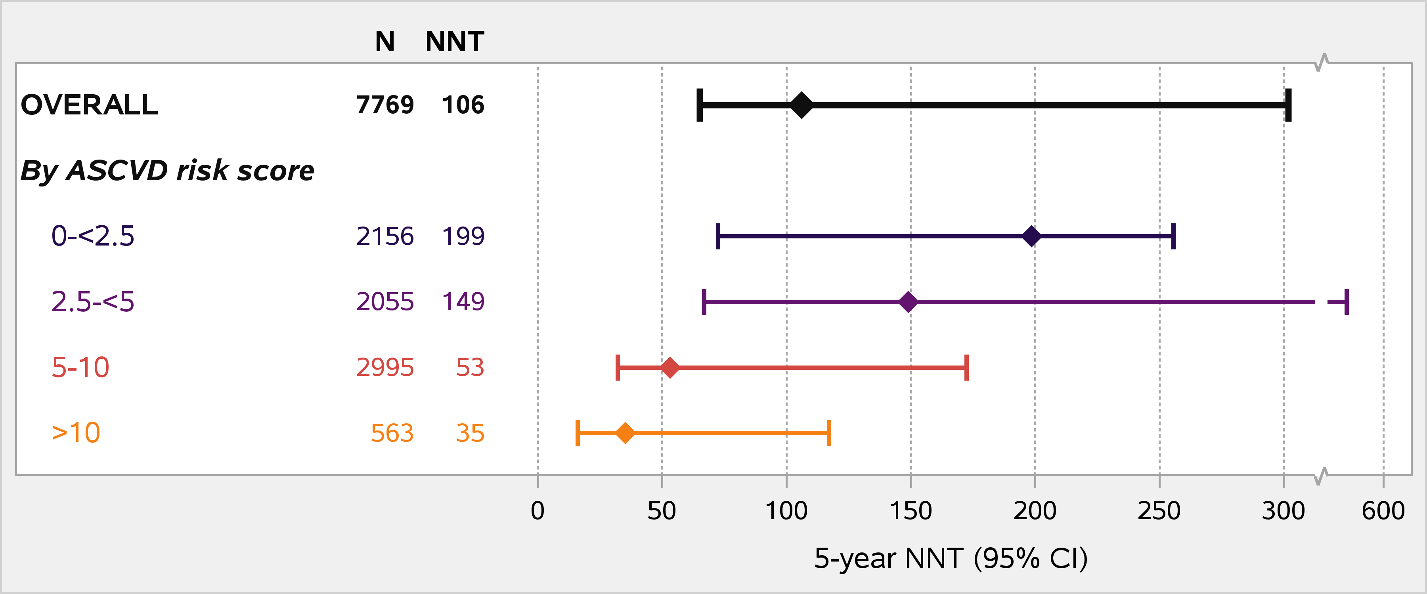
5-Yr Number Needed To Treat (NNT) to Prevent One MACE Event
Increasing CVD with increasing ASCVD risk score
Decreasing NNT with increasing ASCVD risk score
NNT = number needed to treat
Grinspoon et al. NEJM 2023
Notes:
The number needed to treat (NNT) is the number of people that need to be treated to prevent one event (MACE). The overall NNT was 106. In the placebo group, there was an increased incidence of MACE as your baseline risk increased, and this means that the NNT should decrease with increasing risk. For participants with a baseline risk >10%, the NNT was 35. For participants with a risk between 5-10, the NNT was 53.

Slide 31
Will Pitavastatin be Available After REPRIEVE?
The data from REPRIEVE are specific to pitavastatin, chosen because:
little interaction with ART
potent lipid lowering and anti-inflammatory effects
Pitavastatin is available in many countries, but if it is not available, other statins that do not interact with ART may be effective
Generic pitavastatin calcium will be more broadly available after Nov. 2023

Slide 32
Implications for Care of PWH
Statin therapy, with lifestyle counselling, should be considered for PWH, even those with low to moderate predicted traditional risk, to reduce major cardiovascular events and death
For PWH, the decision to take a statin should be individualized
Shared decision making between individual and clinician
All relevant factors including statin risks and benefits should be considered, including but not limited to the results of REPRIEVE. This may include drug interactions, metabolic factors, and patient preferences
All conversations about risk should emphasize a heart healthy lifestyle, ideal diet, counselling on smoking, blood pressure, dyslipidemia, other CVD risks

Slide 33
Conclusions
Despite HIV being considered a risk equivalent, no prior trial has assessed a primary prevention strategy for this group, who would not typically be recommended for statin therapy
Among PWH 40-75, on ART, with low to moderate risk and normal range LDL, treatment with pitavastatin is effective and prevents MACE
Considerations should be given to expanding treatment guidelines in this regard

